Slide 1
How to evaluate a corpus
Adam Kilgarriff
with: Vit Baisa, Milos Jakubicek, Vojtech Kovar, Pavel Rychly
Lexical Computing Ltd and
Leeds University / FI, Masaryk University
UK

Slide 2
Linguistics in 21st century
Corpus evidence
Which data?

Slide 3
NLP/Language Tech in 21st century
Learning from data
Which data?

Slide 4
Two situations
Where target text type is known
Best match
Where it is not
“General language”
Linguistics
Lexicography
Training
Taggers, parsers etc
Lexical acquisition
Our topic

Slide 5
Prior work

Slide 6
“It depends on the task”
Yes but
Start somewhere
Until disproved:
Working hypothesis
Good for one, good for all

Slide 7
We all agree
Big: good
Diverse: good
Duplicates: bad
Junk: bad

Slide 8
A practical matter
2000
No choice
Use whatever there is
2013
German:
DeWaC or TIGER or BBAW or Leipzig …
Build you own corpus
BootCaT, WaC family, TenTen family
What parameters?

Slide 9
Intrinsic/extrinsic
Intrinsic
Assess features of the corpus
Extrinsic
Does it help you do some task better?

Slide 10
Intrinsic/extrinsic
Intrinsic
Assess features of the corpus
Limited
Extrinsic
Does it help you do some task better?
More convincing

Slide 11
A task with
Broad coverage, general language
Norms of language
Hanks 2013
Sensitive to quality
Not too many dependencies
Eg on other complex software
evaluable

Slide 12
Collocation dictionary creation
Model
For English
Oxford Collocations Dictionary (2002, 2009)

Slide 13
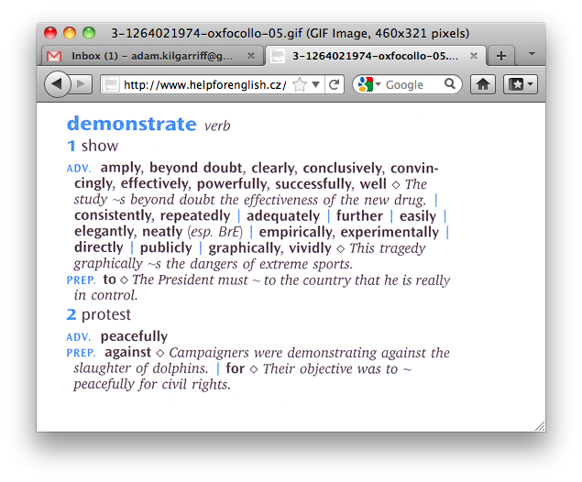

Slide 14
Collocation dictionary creation
Model
For English
Oxford Collocations Dictionary (2002, 2009)
Definition:
A collocation is good = it should be in a dictionary like the OCD

Slide 15
Evaluable?
Collocation dictionaries exist
The people who wrote them answered the question
Ergo yes

Slide 16
Version 1
Sample of headwords
Find collocations
Ask lexicographers
Are they good?

Slide 17
Evaluating word sketches
Word sketch
A one-page, automatic summary of a word’s grammatical and collocational behaviour

Slide 18
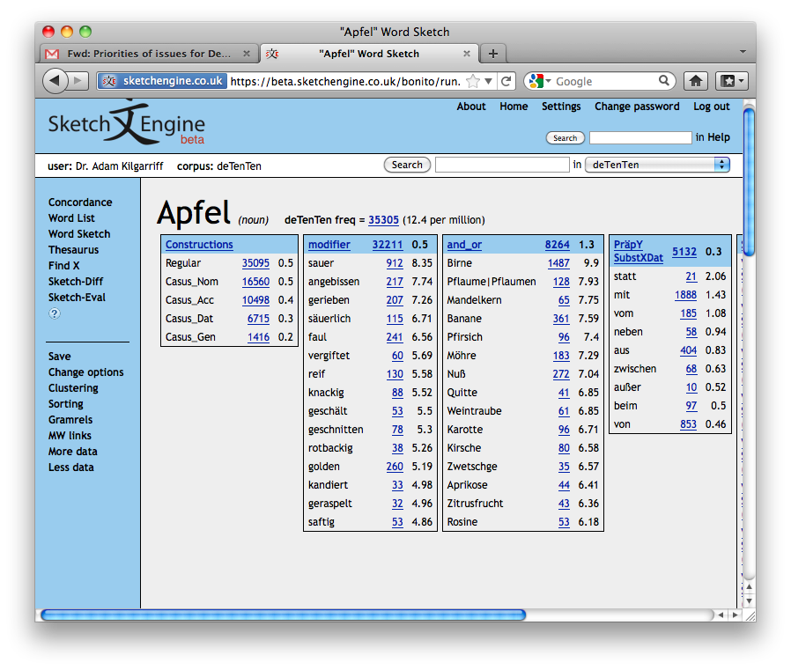

Slide 19
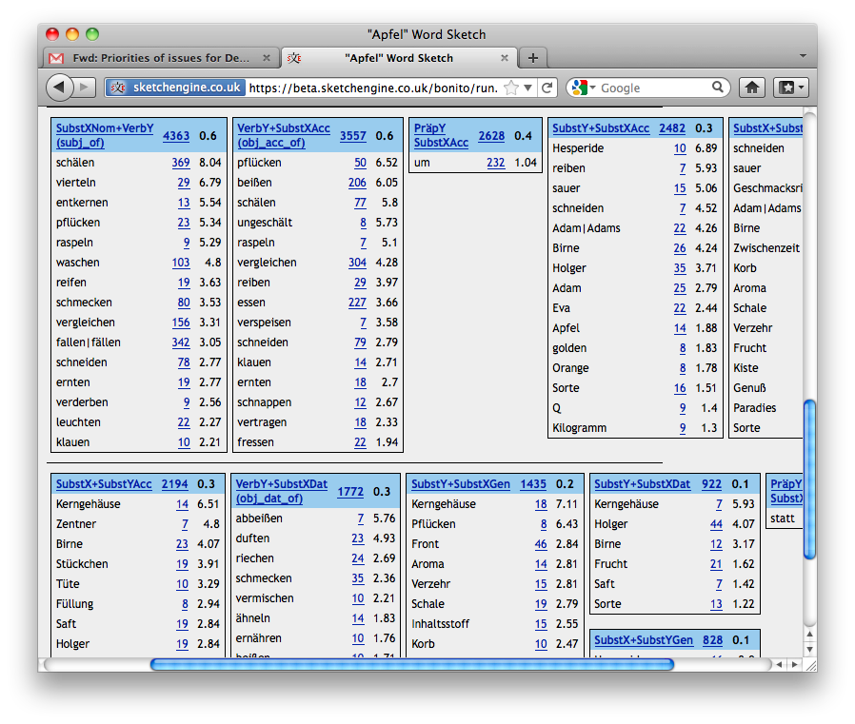

Slide 20
The Sketch Engine
Leading corpus tool
Dictionary-making
Oxford Univ Press, Cambridge Univ Press, Collins, Macmillan, Le Robert, Cornelsen
I[BCDES]L
Research
Linguistics (theoretical and applied), NLP
Teaching
Languages (EFL), Degrees in a lg, Translation

Slide 21
Concordances

Slide 23
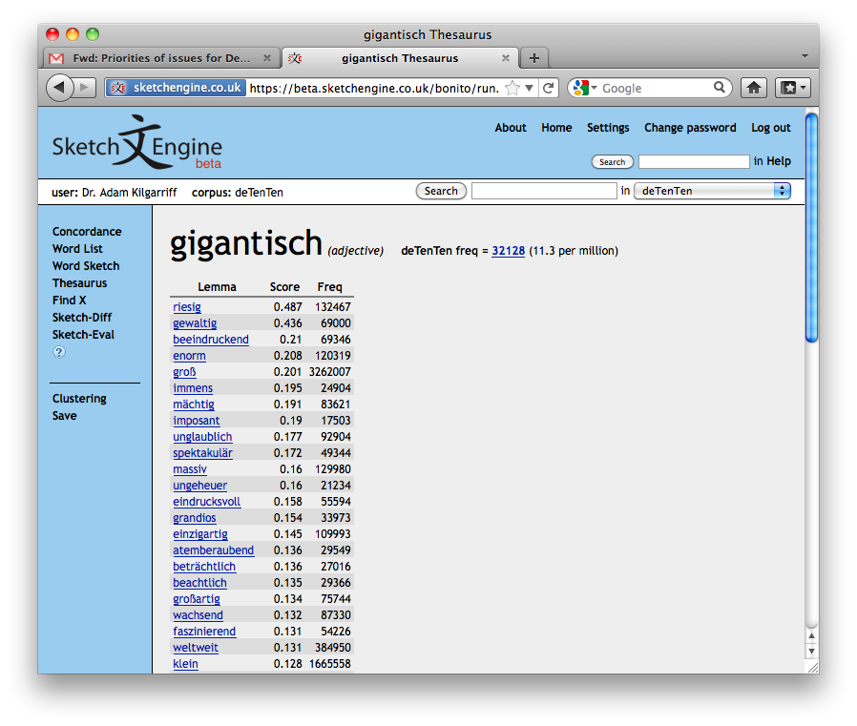

Slide 24
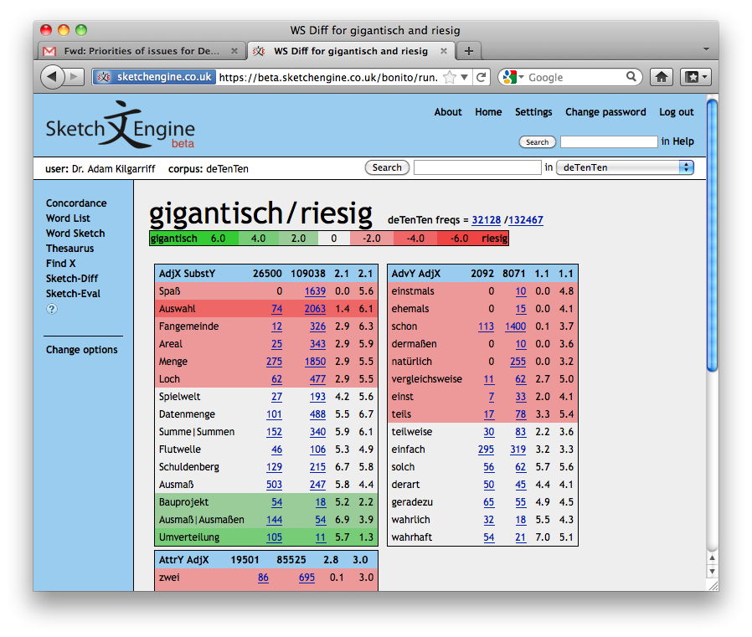

Slide 25
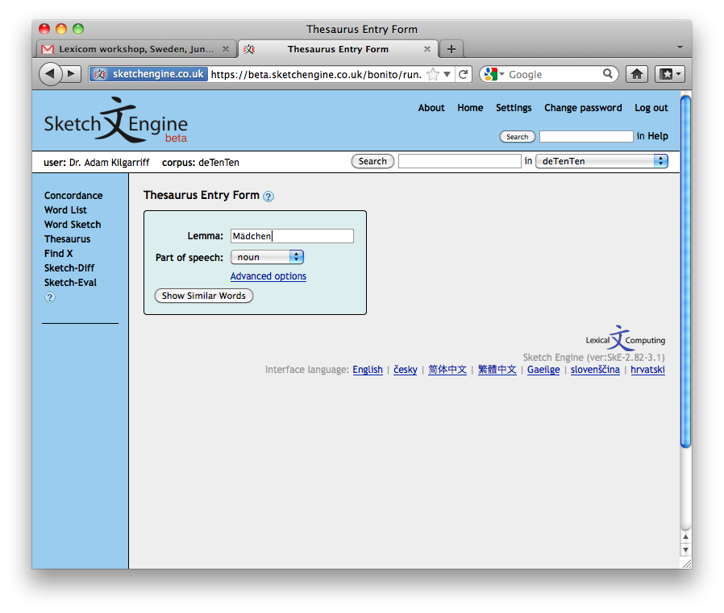

Slide 26
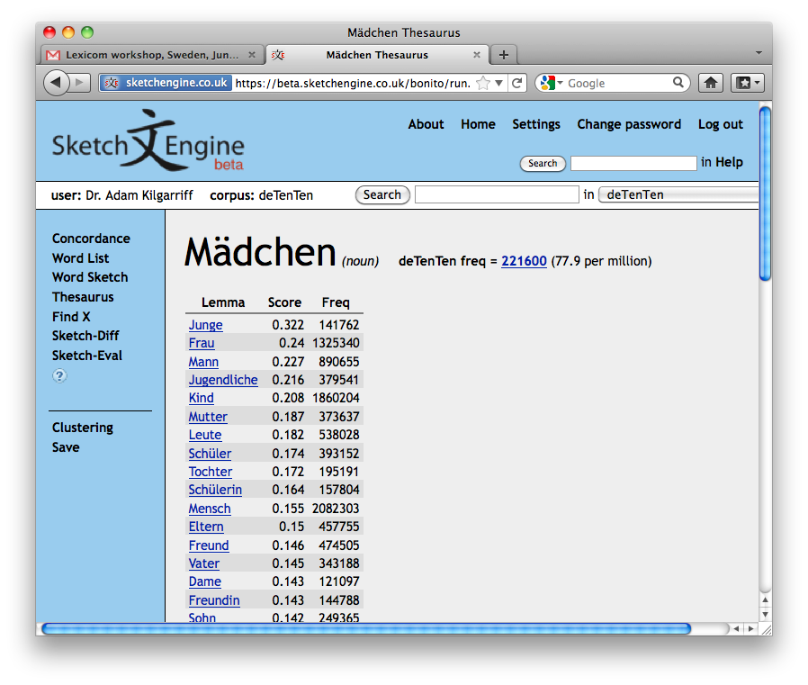

Slide 28
Corpora in SkE
Preloaded
Mostly from web
Sixty languages
Major languages
enTenTen corpora, billions of words
Your own
Uploaded from your computer
Built from web
WebBootCaT

Slide 29
Evaluation
Ten years of word sketches
First product
Macmillan English Dictionary 2002
Feedback
Very good
But
Time for quantitative evaluation

Slide 30
Version 1
Sample of headwords
Find collocations
Ask lexicographers
Are they good?
Four languages
Dutch English Japanese Slovene
Two thirds of top 20 collocations: good
Evaluating word sketches, Euralex 2010

Slide 31
Version 1
Sample of headwords
Find collocations
Ask lexicographers
Are they good?
But
How to find collocations?
Unless we find them all
Measures precision only, not recall

Slide 32
Version 2
Sample of headwords
Find all candidate collocations from everywhere
Ask lexicographers
Are they good?
Gold standard
output of perfect corpus+system
How does corpus X + system Y score?
Vary X, evaluate corpora
Vary Y (or its components), evaluate systems

Slide 33
Task definition
A pair (unordered) of lemmas
No grammar, word class
Would be a problem for comparing systems
Just two words
Simpler to assess, score, compare
Maybe later…
No grammar words
use stoplist
No names
nothing capitalised, in English, Czech

Slide 34
Sample English total size 100
Hi | Hi | Med | Low
Noun | Building Classroom Participant | Blunder Topography Commoner | Flame Gauge Ram
Adjective | Average Black Operational | Delicate Worthwhile Semantic | Evocative Tempting Popup
Verb | Identify Matter Like | Instigate Shelter Kid | Attribute Inject Tire

Slide 35
Sample Czech total size 100
Hi | Hi | Med | Low
Noun | Dukac Federace Prislusnik | Box Najezd Zaplaceni | Hadicka Ilustrator Metrak
Adjective | Dopravni Minimalni Slozity | Dokonceny Pedagogicky Casny | Hunaty Usity Posesdly
Verb | Jednat Pozadat Zpusobit | Dychat Naplanovat Zkratit | Vyhazozat Zaleknout Odstat

Slide 36
Finding all the collocations
Find lots and lots of candidates
All the corpora we had
Various parameters
Check many dictionaries
Number of candidates
For each
Ask three judges
Is it good?
High | 500 | Mid | 250 | Low | 125

Slide 37
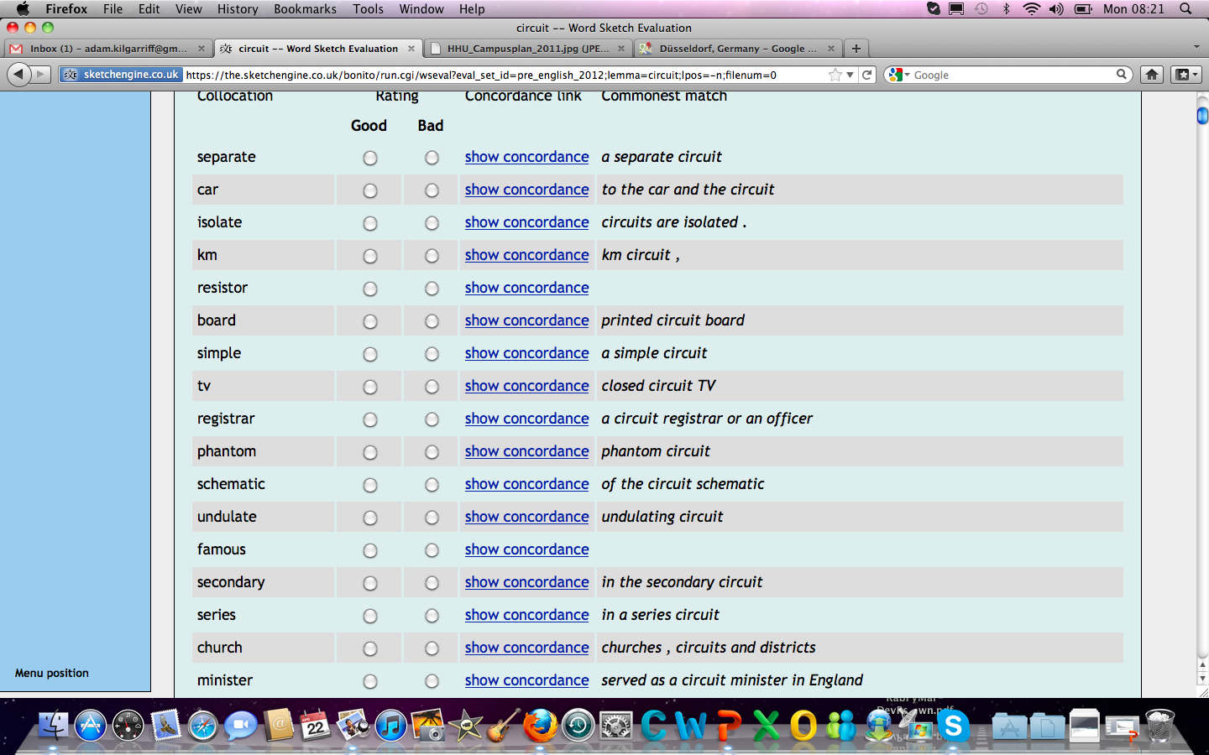

Slide 38
Judging
English
3 lexicographers who had worked on OCD
Czech
4 linguistics students
30,000 judgments each
A few days work

Slide 39
Inter-tagger agreement
 | Czech | English
How many candidates were good? | 4-24% | 16-26%
Pairwise agreement | 74%-90%* | 81-86%
Pairwise kappa | 0-09-0.5 | 0.44-0.5
Good=
All, or all-but-one, of judges said ‘good’

Slide 40
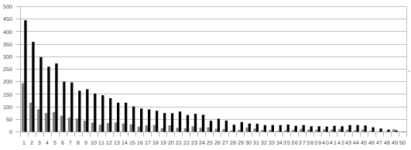
Did we find all good collocates?
Distribution of good collocations in fiftieths, ordered by score.
English is black, Czech grey.

Slide 41
Did we find all good collocates?
Probably not

Slide 42
Sample with good-collocate counts English total size 100
Hi | Hi | Med | Low
Noun max med min | Building 199 Classroom 90 Participant 36 | Blunder 63 Topography 18 Commoner 4 | Flame 85 Gauge 38 Ram 21
Adjective max med min | Average 176 Black 118 Operational 49 | Delicate 43 Worthwhile 25 Semantic 12 | Evocative 43 Tempting 25 Popup 12
Verb max med min | Identify 95 Matter 45 Like 20 | Instigate 58 Shelter 15 Kid 8 | Attribute 91 Inject 30 Tire 7

Slide 43
Review
Sample of headwords
Find all candidate collocations from everywhere
Ask lexicographers
Are they good?
Gold standard
output of perfect corpus+system
How does corpus X + system Y score?
Vary X, evaluate corpora
Vary Y (or its components), evaluate systems

Slide 44
Corpora
Czech | mwords | English | mwords
Czes2-Synt | 368, parsed | enTenTen12 | 111,192
Czes2-SET | 368, parsed | enTenTen08 | 2759
SYN | 1568 | UKWAC | 1319
czTenTen12 | 4791 | BNC | 96
SYN2009PUB | 844 | NMCorpus | 95
SYN2006PUB | 361 | OEC | 2073
SYN2010 | 121 | ACL ARC | 40
Czes2 | 368
SYN2005 | 122
SYN2000 | 120
CzechParl | 45

Slide 45
Parameters
Precision/recall tradeoff
How many collocates to choose
Best: Hi 100, Mid 50, Lo 25
What metric to use
F5 weights recall (harder) over precision
Suitable here
Statistic to sort by
Czech: better with Dice (salience measure)
English: better with plain frequency
Minimum hits for collocate (1, 5, 10)

Slide 46
Results
Czech | mwords | F-5 | English | mwords | F-5
Czes2-Synt | 368, parsed | 42.4 | enTenTen12 | 111,192 | 34.3
Czes2-SET | 368, parsed | 39.2 | enTenTen08 | 2759 | 34.1
SYN | 1568 | 34.2 | UKWAC | 1319 | 32.6
czTenTen12 | 4791 | 33.6 | BNC (TreeT) | 96 | 29.2
SYN2009PUB | 844 | 33.5 | BNC (CLAWS) | 96 | 28.9
SYN2006PUB | 361 | 32.8 | NMCorpus | 95 | 28.4
SYN2010 | 121 | 32.8 | OEC | 2073 | 28.1
Czes2 | 368 | 32.6 | ACL ARC | 40 | 12.0
SYN2005 | 122 | 32.5
SYN2000 | 120 | 27.3
CzechParl | 45 | 14.7

Slide 47
Discussion
Big: good
Czech: parsing helps
En: TreeTagger better than CLAWS

Slide 48
What about OEC?
Curated and big
Low score
NOT used to find candidates

Slide 49
OEC experiment
Extra candidates from OUP
Extra task for judges
19% of new candidates were good
Conclusion
Did we find all good collocations?
No

Slide 50
Just-in-time evaluation
New corpus to ‘add to set’
Same headwords
Same candidate-finding algorithm, parameters
Find candidates for new corpus
Judge them
Rerun evaluation with extended set
New corpus can be compared with others
OEC: in progress

Slide 51
To do
OEC: complete (also CLUEWEB)
Gold standard datasets for taggers, parsers
Usable for corpus evaluation?
Comparable results?
Use cases!
Set parameters for web corpus construction
Deduplication
Seeds
Crawling strategies
Processing tools

Slide 52
Thank you

