Slide 1
Getting to know your corpus
Adam Kilgarriff
Lexical Computing Ltd

Slide 2
Bad Science
Ben Goldacre

Slide 3
Bad Science
Ben Goldacre
Biases in samples
  A quarter of the people who tested positive had just been on holiday in Mexico
  But the research team didn’t notice

Slide 4
Bad linguistics
Our corpus study shows X
  But what was in the corpus?

Slide 5
Bad linguistics
Our corpus study shows X
  But what was in the corpus?
  Moral:
    Get to know your corpus

Slide 6
How?
Read it?
Too big to read
Not designed to be read

Slide 7
How?
Compare it with other(s)
Keyword lists

Slide 8
UKWaC vs. enTenTen12

Slide 9
enTenTen vs. UKWaC
accord actually amendment among bad because behavior believe bill blog ca center citizen color defense determine do dollar earth effort election even evil fact faculty favor favorite federal foreign forth guess guy he her him himself his honor human kid kill kind know labor law let liberal like man maybe me military movie my nation never nor not nothing official oh organization percent political post president pretty professor program realize recognize say shall she sin soul speak state suppose tell terrorist that thing think thou thy toward true truth unto upon violation vote voter war what while why woman yes
accommodation achieve advice aim area assessment available band behaviour building centre charity click client club colour consultation contact council delivery detail develop development disabled email enable enquiry ensure event excellent facility favourite full further garden guidance guide holiday improve information insurance join link local main manage management match mm nd offer opportunity organisation organise page partnership please pm poker pp programme project pub pupil quality range rd realise recognise road route scheme sector service shop site skill specialist st staff stage suitable telephone th top tour training transport uk undertake venue village visit visitor website welcome whilst wide workshop www

Slide 10
enTenTen vs. UKWaC
accord actually amendment among bad because behavior believe bill blog ca center citizen color defense determine do dollar earth effort election even evil fact faculty favor favorite federal foreign forth guess guy he her him himself his honor human kid kill kind know labor law let liberal like man maybe me military movie my nation never nor not nothing official oh organization percent political post president pretty professor program realize recognize say shall she sin soul speak state suppose tell terrorist that thing think thou thy toward true truth unto upon violation vote voter war what while why woman yes
accommodation achieve advice aim area assessment available band behaviour building centre charity click client club colour consultation contact council delivery detail develop development disabled email enable enquiry ensure event excellent facility favourite full further garden guidance guide holiday improve information insurance join link local main manage management match mm nd offer opportunity organisation organise page partnership please pm poker pp programme project pub pupil quality range rd realise recognise road route scheme sector service shop site skill specialist st staff stage suitable telephone th top tour training transport uk undertake venue village visit visitor website welcome whilst wide workshop www

Slide 11
enTenTen vs. UKWaC
accord actually amendment among bad because behavior believe bill blog ca center citizen color defense determine do dollar earth effort election even evil fact faculty favor favorite federal foreign forth guess guy he her him himself his honor human kid kill kind know labor law let liberal like man maybe me military movie my nation never nor not nothing official oh organization percent political post president pretty professor program realize recognize say shall she sin soul speak state suppose tell terrorist that thing think thou thy toward true truth unto upon violation vote voter war what while why woman yes
accommodation achieve advice aim area assessment available band behaviour building centre charity click client club colour consultation contact council delivery detail develop development disabled email enable enquiry ensure event excellent facility favourite full further garden guidance guide holiday improve information insurance join link local main manage management match mm nd offer opportunity organisation organise page partnership please pm poker pp programme project pub pupil quality range rd realise recognise road route scheme sector service shop site skill specialist st staff stage suitable telephone th top tour training transport uk undertake venue village visit visitor website welcome whilst wide workshop www

Slide 12
enTenTen vs. UKWaC
accord actually amendment among bad because behavior believe bill blog ca center citizen color defense determine do dollar earth effort election even evil fact faculty favor favorite federal foreign forth guess guy he her him himself his honor human kid kill kind know labor law let liberal like man maybe me military movie my nation never nor not nothing official oh organization percent political post president pretty professor program realize recognize say shall she sin soul speak state suppose tell terrorist that thing think thou thy toward true truth unto upon violation vote voter war what while why woman yes
accommodation achieve advice aim area assessment available band behaviour building centre charity click client club colour consultation contact council delivery detail develop development disabled email enable enquiry ensure event excellent facility favourite full further garden guidance guide holiday improve information insurance join link local main manage management match mm nd offer opportunity organisation organise page partnership please pm poker pp programme project pub pupil quality range rd realise recognise road route scheme sector service shop site skill specialist st staff stage suitable telephone th top tour training transport uk undertake venue village visit visitor website welcome whilst wide workshop www

Slide 13
enTenTen vs. UKWaC
Core verbs
  be determine do guess know let say shall suppose tell think
Pronouns
  he her him his me my she
Biber: more informal

Slide 14
Two cultures
Famous book in England: C.P. Snow
Humanities vs. science
Linguistics: languages vs computer science
Lancaster, Leeds: both ☺

Slide 15
Judgements
Not all or nothing
  Both have (lots of) AmE and BrE
  Observing patterns
    Not right or wrong
    Where does ‘believe’ belong?
      Bible or core verbs?
      No right answer, could be both
The better you know the data, the better you understand why words are there

Slide 16
The maths
“this word is twice as common here as there”
Simplest approach
  Normalise frequencies
    Per thousand, or per million
  Take ratio
For examples
  Assume two 1m-word corpora
    Normalisation not needed
  Fc=focus corpus
  Rc= reference corpus

Slide 17
Problem 1: You can’t divide by zero
Standard solution: add one
Problem solved
 | fc | rc | ratio
buggle | 10 | 0 | ?
stort | 100 | 0 | ?
nammikin | 1000 | 0 | ?
 | fc | rc | ratio
buggle | 11 | 1 | 11
stort | 101 | 1 | 101
nammikin | 1001 | 1 | 1001

Slide 18
Problem 2: High ratios more common, less interesting for rarer words
 | fc | rc | ratio | interesting?
spug | 10 | 1 | 10 | no
grod | 1000 | 100 | 10 | yes
ratio is not enough: frequency matters too
Also
some researchers: grammar, grammar words
some researchers: lexis, content words
No right answer
Slider?

Slide 19
Solution
Don’t just add 1, add n:
n=1
n=100
word | fc | rc | fc+n | rc+n | Ratio | Rank
obscurish | 10 | 0 | 11 | 1 | 11.00 | 1
middling | 200 | 100 | 201 | 101 | 1.99 | 2
common | 12000 | 10000 | 12001 | 10001 | 1.20 | 3
word | fc | rc | fc+n | rc+n | Ratio | Rank
obscurish | 10 | 0 | 110 | 100 | 1.10 | 3
middling | 200 | 100 | 300 | 200 | 1.50 | 1
common | 12000 | 10000 | 12100 | 10100 | 1.20 | 2

Slide 20
n=1000
word | fc | rc | fc+n | rc+n | Ratio | Rank
obscurish | 10 | 0 | 1010 | 1000 | 1.01 | 3
middling | 200 | 100 | 1200 | 1100 | 1.09 | 2
common | 12000 | 10000 | 13000 | 11000 | 1.18 | 1

Slide 21
Summary
word | fc | rc | n=1 | n=100 | n=1000
obscurish | 10 | 0 | 1st | 2nd | 3rd
middling | 200 | 100 | 2nd | 1st | 2nd
common | 12000 | 10000 | 3rd | 3rd | 1st

Slide 22
But what about
Mutual information
Log-likelihood
Chi-square
Fisher’s test
…
Don’t they use cleverer maths?

Slide 23
Yes but
Clever maths is for hypothesis testing
  Can you defeat null hypothesis?
Language is not random, so
… you always can
Null hypothesis never true
Hypothesis-testing not informative
Clever maths irrelevant
  Kilgarriff 2006, CLLT

Slide 24
Varying the parameter
BAWE
  British Academic Written English
    Nesi and Thompson 2008
  Student essays
    Arts/Humanities, Social Sciences, Life Sciences, Physical Sciences
  fc: ArtsHum, rc: SocSci
  With n=10 and n=1000

Slide 25
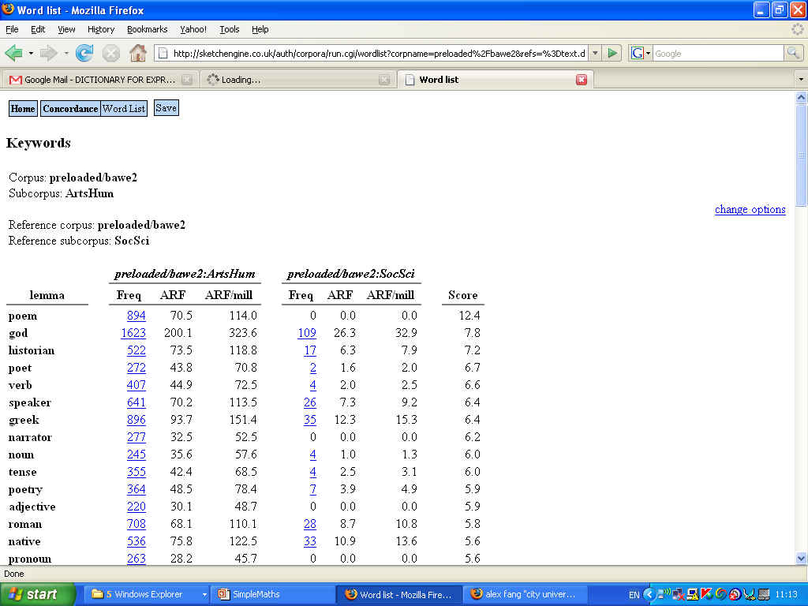

Slide 26
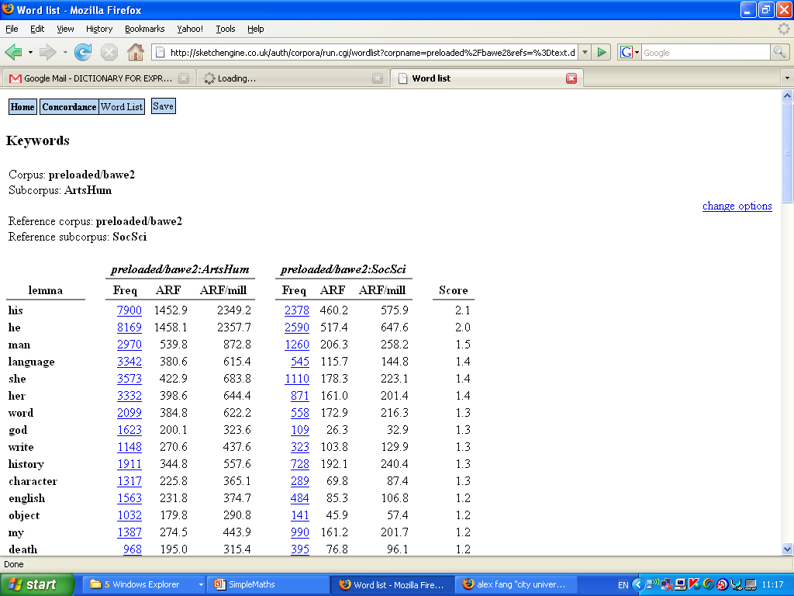

Slide 27
Parameters for keyword lists
Lemmas
  Could be word forms, word classes
Simplemaths
  (default: 100, for mix of lexical and grammar words)
Only all-lowercase-letters
  Could allow uppercase, or any at all
Minimum 2/3/4 characters
  Helps get words, not abbreviations etc

Slide 28
enTenTen vs. UKWaC
Obama Clinton Hillary McCain
Centre Leeds Manchester Edinburgh
With parameters:
Simplemaths: 10
Uppercase and lowercase
Minimum length =5 (to exclude acronyms)

Slide 29
Two interlocking questions
How do two corpora differ
How do two text types differ

Slide 30
Two interlocking questions
How do two corpora differ
  enTenTen vs. UKWaC
  Interpret as:
    Differences of corpus compilation procedures
    - and/or -
    Differences of proportions of text types
How do two text types differ
  BAWE example
    Arts/humanities essays vs. Social Sciences essays
  Any other corpus differences
    Unwanted biases
    But we need to know about them

Slide 31
Designed vs crawled
Two main ways to build a large corpus
Design
  Start from design spec
  Select data to fit spec
Crawl
  Crawl the web, you get what you get
Hot topic
  Designed (BNC, CNC): more expensive
  Crawled (*WaC, *TenTen): can you trust it

Slide 33
enTenTen keywords
Pronouns: our your
Encoding: don percent
Web: com site email request server internet comments click website online posted web list access data search www files file blog address page
University: article campus faculty graduate information project projects read research science student students
American spelling : behavior center color defense favor favorite labor organizations program programs toward
Bible: believe evil faith forth sin soul thee thou thy unto upon
Politics: current federal global laws nation president security world
Creative industries: author content create digital film game images media movie review story technology
Informal: folks guess guy guys kids
Language change: issues
Other: code efforts entire focus human include including human located mission persons prior provides
BNC keywords
Pronouns: he herself her
Encoding Speech: transcription: cos cent erm gon per pound pounds
Numbers: eight fifty five forty four half hundred nine nineteen seven six ten thirty three twenty two
British spelling: behaviour centre colour defence favour labour programme round towards
British lexical variants: bloody pupils shop
Past tense verbs: got felt turned smiled sat looked stood was said been seemed had went were knew put thought
Particles: away back down off
Local government: council firm hospital local industrial police social speaker
Household nouns: bed car door eyes face garden girl hair house kitchen mother room tea
Informal: alright mean quite perhaps sort yeah yes
Language change: chairman
Other: although club considerable could head know main manager night there studio yesterday

Slide 34
Contrasts in both Cz and En
Crawled
1st and 2nd person forms
Web
Designed
Time
Numbers
Past tenses

Slide 35
EnTenTen vs. UKWaC and BNC
(American)
Bible
Politics/election
University

Slide 36
EnTenTen vs. UKWaC and BNC
(American)
Bible
Politics/election
University
Compare A and B
is it a bias of A, or of B?
Compare, A, B and C
More vantage points, triangulation
Get to know your corpus better

Slide 37
Quantitative comparison
- but isn’t enTenTen more similar to UKWaC than BNC
Talk so far: qualitative
For this question: quantitative
  Distance between two corpora
Kilgarriff 2001: Comparing Corpora
  Now implemented in Sketch Engine

Slide 38
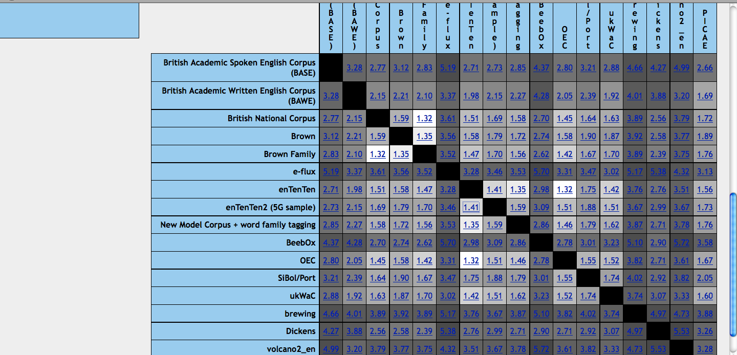

Slide 39
Summary
Don’t do bad science
Get to know your corpus
  Compare with others
    Qualitatively: keyword lists
    Quantitatively: distances
No excuses
  The Sketch Engine does all the technical work for you
The joy of research

Slide 40
Thank you http://www.sketchengine.co.uk

