Slide 1
Genre in a Frequency Dictionary
Adam Kilgarriff & Carole Tiberius

Slide 2
Outline
Three problems
Our solutions

Slide 3
Routledge Frequency Dictionaries
Ten languages/volumes so far
Series editors: Mark Davies, Paul Rayson
“5000 most frequently used words”
Genre/text type?
Some marking
Like traditional dictionaries

Slide 4
The corpus linguist’s dilemma
We know that
Everything depends on text type
Usually
Ignore
Pretend our corpus is representative
(or we even knew what it meant)
Frequency dictionary
Specially painful

Slide 5
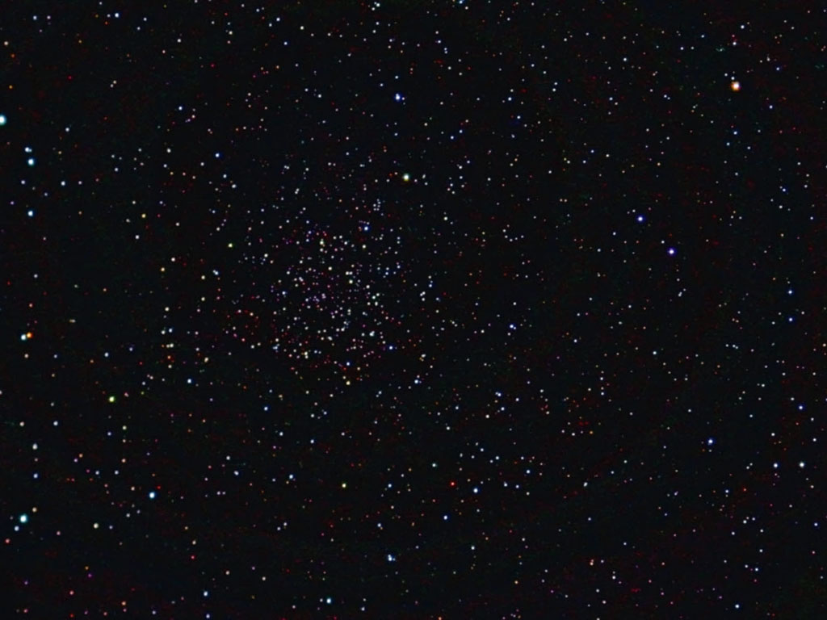
Poetic interlude
As many texts
as stars in the sky
As many domains
as constellations
As many genres
as stories to tell about them
Represent them?
Shucks

Slide 6
A tiny step in the direction of respecting the importance of genre
Instead of just one list
One list per genre

Slide 7
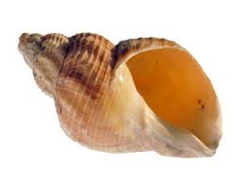
The Whelks Problem
Rare word but
a book about whelks uses it hundreds of times
Solution
document frequency

Slide 8
The genius of Brown
Fixed sample size
500 x 2000-word samples
Makes the maths easy
Frequencies directly comparable
Document frequency works
No need to compensate for different sample length
Contra Sinclair, Hanks
Different goals
Brown: very widely used, replicated

Slide 9
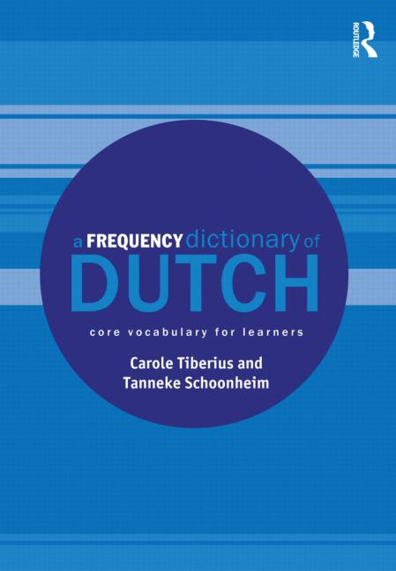
A Frequency Dictionary of Dutch
In the Routledge series
Publication later this year

Slide 10
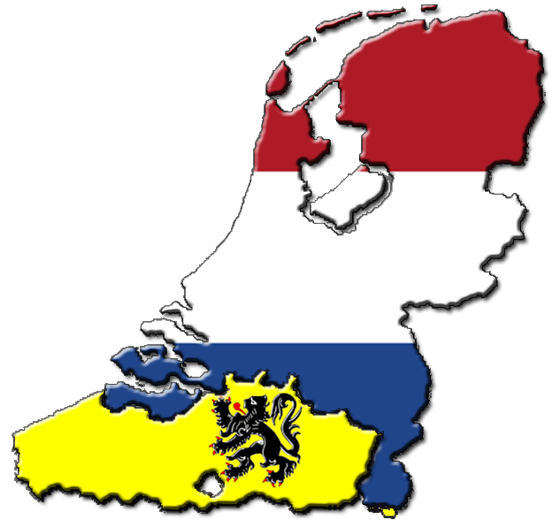
Dutch
Written and Spoken
the Netherlands and Flanders
jij, je
pinpas
betaalkaart
gij, ge
Notes:
Dutch is the Standard Language in both the Netherlands and Belgium (Flanders), but there are differences. The pronunciation is different, there are lexical differences and grammatical differences.
For instance, in Belgium the use of the pronoun gij, ge (meaning you) is far more prominent than in Dutch where it’s only used in dialects. The corpus material was chosen such as to cover Dutch as it is spoken in the Netherlands and in Flanders.

Slide 11
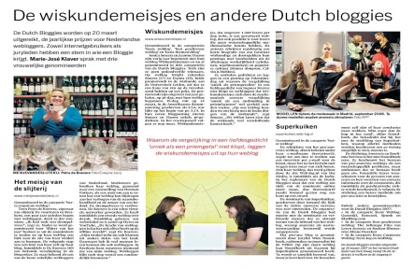
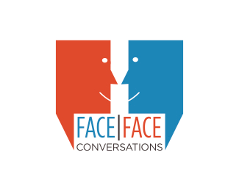
The Corpus
Fiction
25 books per year, 1970-2009
Newspapers
From SONAR corpus, 1993-2005.
Spoken
From Corpus Gesproken Mederlands
Web
From SONAR corpus, includes blogs, discussion lists, e-magazines, press releases, websites and wikipedia

Slide 12
Corpus preparation
Tagging
Lemmatisation
Slice corpora into 2000-word samples
http://ilk.uvt.nl/frog/

Slide 13
How many lists?
One list per genre
But – overlap?
Core:
4 genres:
General:

Slide 14
Which words to include
Which list(s) to put them in
Throughout
document frequency, implemented as
percentage of samples that the word occurs in

Slide 15
Inclusion
Include if average across four genres > 1.125
5000 words

Slide 16
Core Vocabulary
words that are used across all kinds of language
implemented as
Words with frequency > x in all genres
4.5 mark gives 943 core-vocab words
in core-vocab only; not in other lists

Slide 17
Which list(s)? The problem
Word | Fiction | News | Spoken | Web
Ham | 20 | 5 | 4 | 3
Egg | 20 | 18 | 4 | 3
Cheese | 20 | 18 | 19 | 3

Slide 18
Our solution
Which list(s)? The problem
Word | Fiction | News | Spoken | Web
Ham | 20 | 5 | 4 | 3
Egg | 20 | 18 | 4 | 3
Cheese | 20 | 18 | 19 | 3
Word | Fiction | News | Spoken | Web | Lists
Ham | 20 | 5 | 4 | 3 | Fiction
Egg | 20 | 18 | 4 | 3 | Fiction, News
Cheese | 20 | 18 | 19 | 3 | General

Slide 19
Algorithm
Minimum > 45.5
The complication is that some words will occur in two, three or four of the lists generated in this way, and for such cases we have to decide whether they go in:
just one list
more than one list
the general list.
Our strategy is to say there should be some cases of each, as follows:
if highest frequency is at least double the next highest, list in that genre only
if two are high and two are low, that is, the first- and second-highest, and both more than double the other two, list in both the top two
else list in general.

Slide 20
Algorithm
Min > 4.5?
Core-vocab
Else
If highest-score > 2 x second-highest-score
Highest-score-genre
Else if second-highest-score > 2 x third-highest-score
Highest-score-genre and second-highest-score-genre
Else
General

Slide 21
The ‘genre’ lists

Slide 22
Observations
Fiction
Broadest vocabulary, longest list
Spoken
Smallest, shortest
Spoken and web: much overlap
Fiction and news: some overlap

Slide 23
In sum
Everything depends on genre
Not easy to handle well in any dictionary
Specially hard in a frequency dictionary
It helps to use
Fixed sample size
Document frequencies (as percentages)
A modest attempt to pay genre due respect
Routledge Frequency Dictionary of Dutch, 2013

Slide 24
Poetic interlude
As many texts
as stars in the sky
As many domains
as constellations
As many genres
as stories to tell about them
Represent them?
Shucks

