Slide 1
Finding multiwords of more than two words
Adam Kilgarriff, Pavel Rychly,
Vojtech Kovar, Vıt Baisa
Lexical Computing Ltd; Masaryk Univ., Cz

Slide 2
Multiwords
Lexical items with spaces in
(Western languages)

Slide 3
Two-word multiwords
Church and Hanks 1989
Mutual information
A statistic that finds multiwords in a corpus
Since
Other statistics
T-score, Log-likelihood, Dice, Fishers Exact Test
Evaluation
Krenn and Evert 2001, many others since
Better with grammar
Wermter and Hahn 2006
Problem solved

Slide 4
More than two words
Problem 1: what to count
Problem 2: statistics
Attempts include
Dias 2002
Petrovic Snajder Basic 2010
Not convincing
No prima facie validity to results
Stats only; no grammar

Slide 5
Responses
Principle:
Word sketches work very well. Build on them
Multiword sketches
Commonest match

Slide 6
Multiword sketches

Slide 7
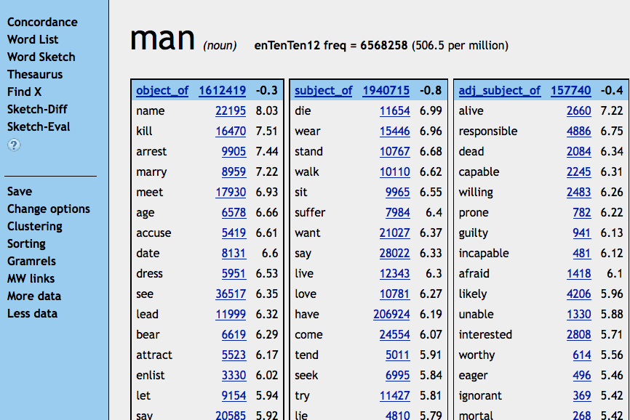

Slide 8
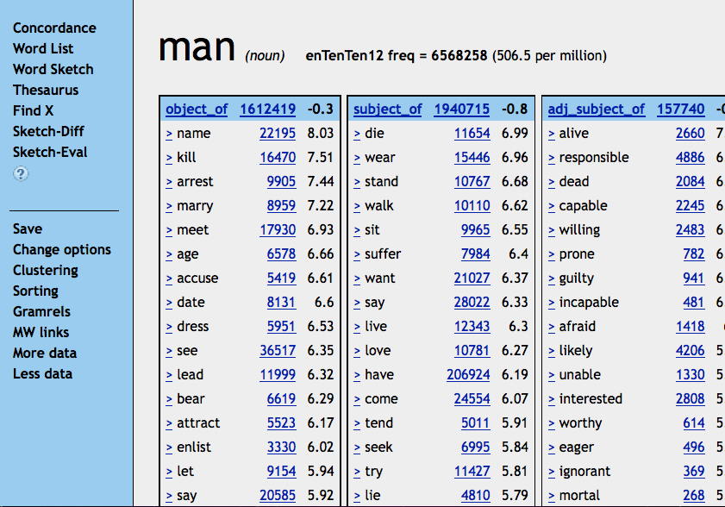

Slide 9
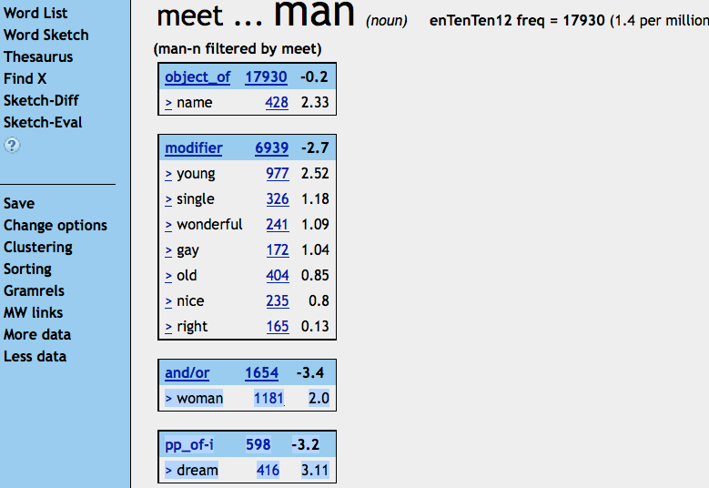

Slide 10
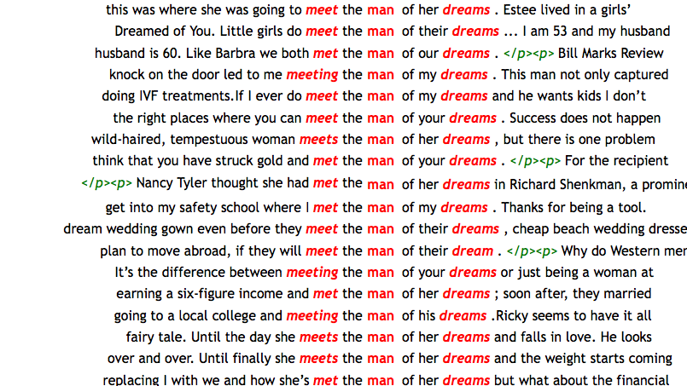

Slide 11
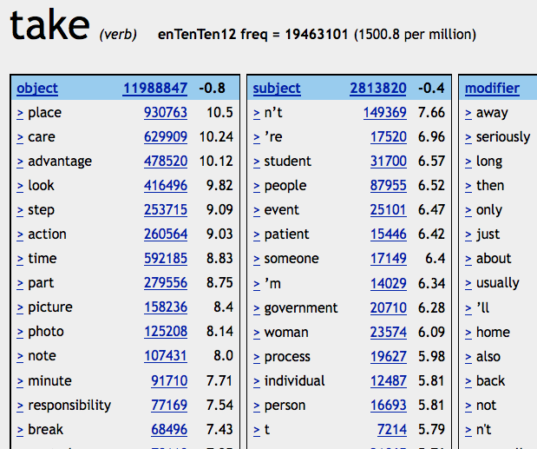

Slide 12
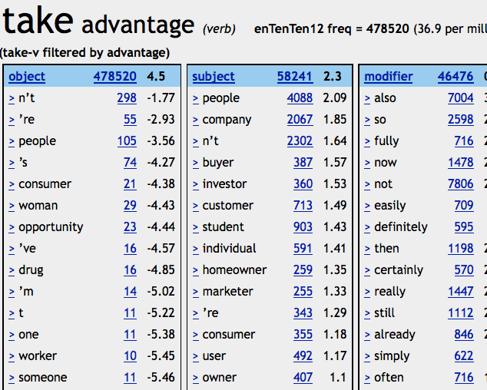

Slide 13
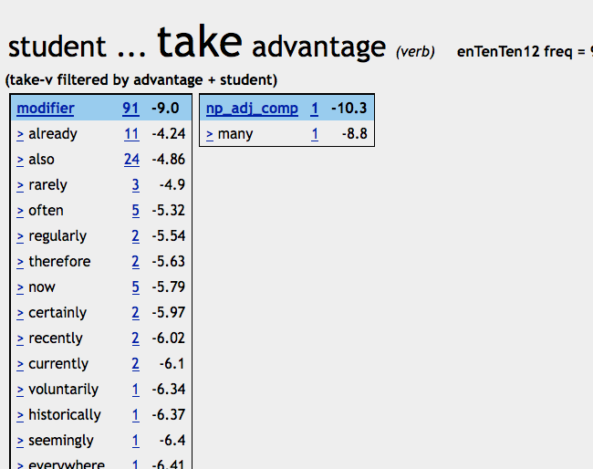

Slide 14
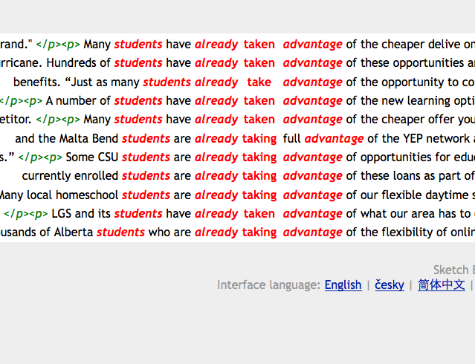

Slide 15
Commonest match
Problem
In our evaluation exercise:
Is world a good collocate of final
first glance
No
Look at concordance
Multiword sketches
Commonest match

Slide 17
Aha

Slide 18
Intuition
Where word1 occurs with word2, do they usually (/often) occur in a particular string?
If yes, show that string
(if no, as now)
Grow the collocation
for as long as the commonest match accounts for plenty of the data

Slide 19
Algorithm
Start: two lemmas forming collocation
Gather all N hits (+ contexts)
Identify the match
From leftmost of the two lemma to rightmost
Commonest match has frequency >= N/4 ?
No: end, return lemma-pair
Yes
Update new_match to match, N to freq of match
New-match = match extended one word to left (/right)
Commonest match has frequency >= N/4 ?
No: end, return match
Yes : return to 1.

Slide 20
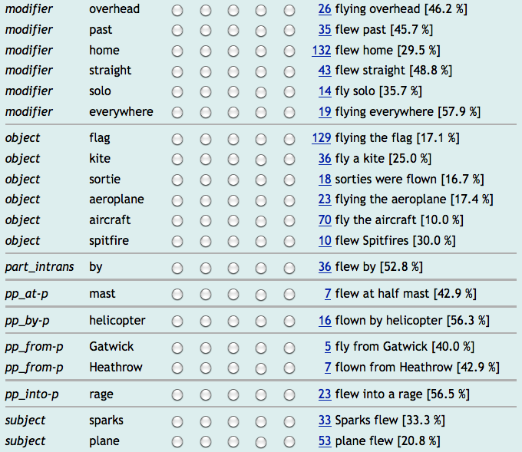

Slide 21
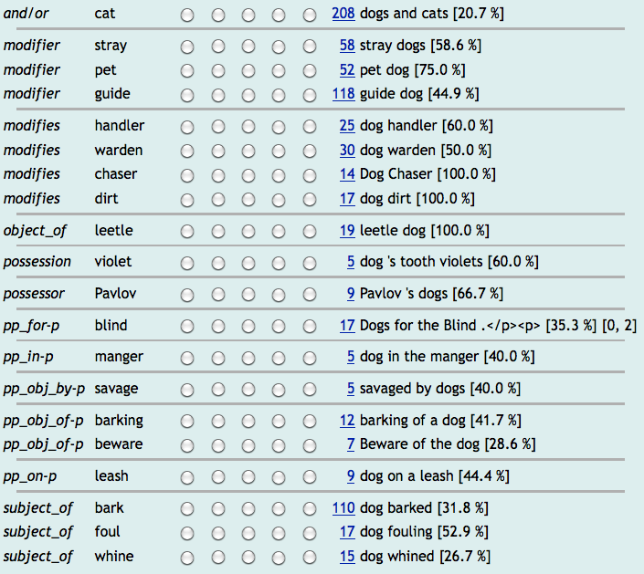

Slide 22
Status and plans
Implemented but too slow
Re-engineering in progress
Then
Alternative-format word sketches
Default?
Don’t show gramrels?
Automatic collocations dictionary
Build into GDEX

Slide 23
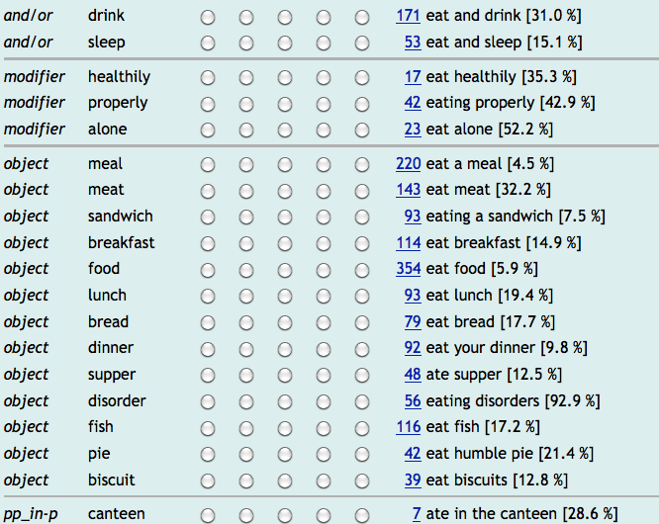

Slide 24
Colligation and collocation

Slide 25
Birmingham vs. Lancaster
Lemmas or word forms?
Grammar or strings?
McEnery and Hardie, Corpus Linguistics, CUP red texbooks

Slide 26
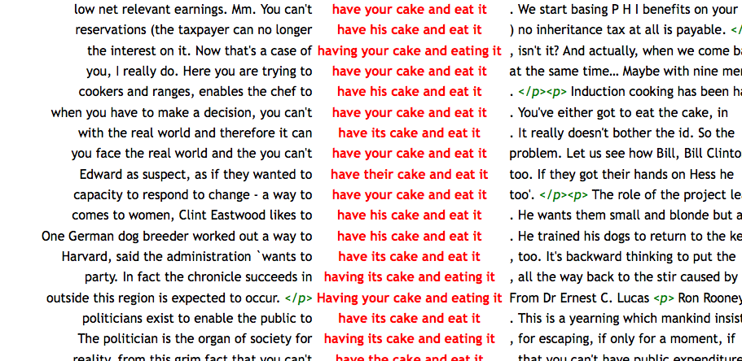

Slide 27
In sum
Two-word multiwords
Solved
More than two
Hard
Build on word sketches
Two implemented solutions
Multiword sketches
Commonest string
Thank you

