Slide 1
The Sketch Engine as Infrastructure for Large Scale Text Collections for Humanities Research
Adam Kilgarriff
Lexical Computing Ltd. & Univ of Leeds, UK

Slide 2
Requirements
Fast
Stable and reliable
Handle collections of any size
Even billions of words
Support complex markup
Wide range of query-types, reports
Live on the web
With access management

Slide 3
Requirements
One infrastructure, many resources
Ten-year-plus timescale
With long term:
Support and maintenance
Ongoing development
Engagement with resource development
University research projects not designed that way
Commercial: advantages

Slide 4
Everything or just text

Slide 5
or

Slide 6
You can’t please all the people all the time

Slide 7
Everything or just text
Vast
Indexing – how?
what search terms?
Solve the world
Small
Indexing
Easy
Divide and rule

Slide 8
Sketch Engine
Text only
Meets all criteria
Ten years
Users
Dictionary-making
Oxford Univ Press, Cambridge Univ Press, Collins, Macmillan, le Robert, Cornelsen
INL and eight other national research institutes
Universities
Research, teaching, language teaching

Slide 9
Linguistics
Text database = corpus (pl: corpora)

Slide 11
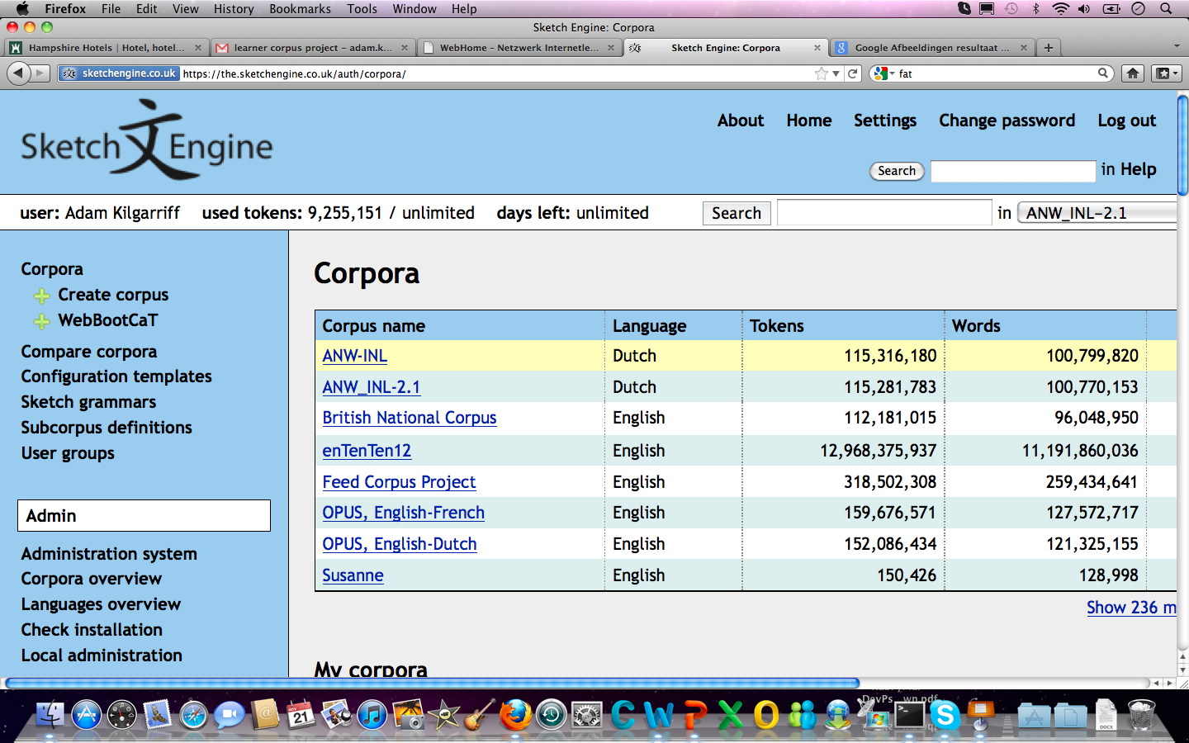

Slide 12
Languages
Around sixty
Main world languages:
“tenten” corpora, order of 10b words
Web scale

Slide 13
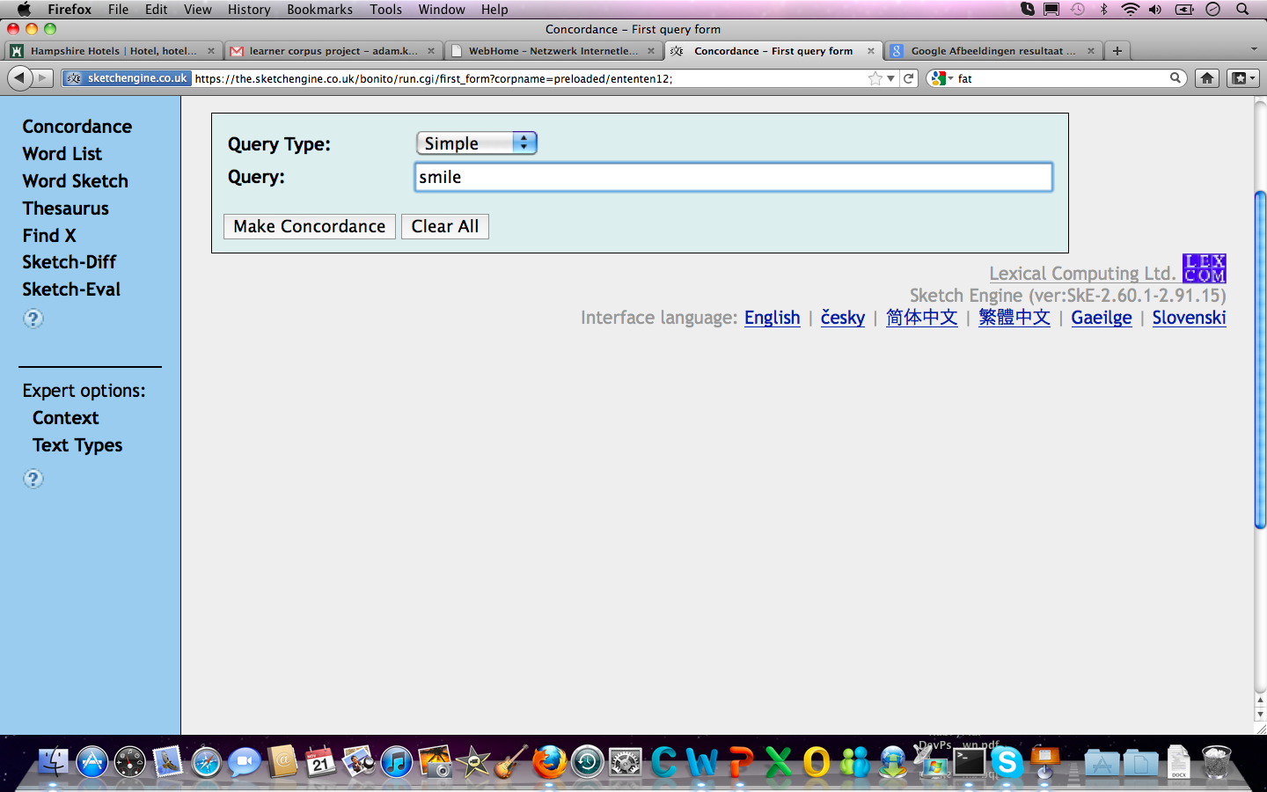

Slide 14
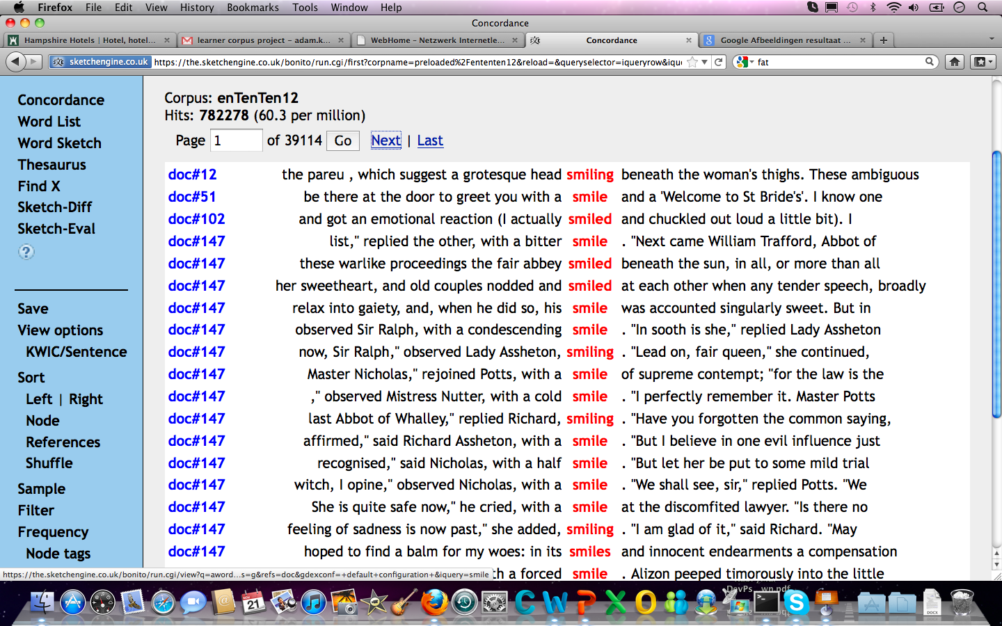

Slide 15
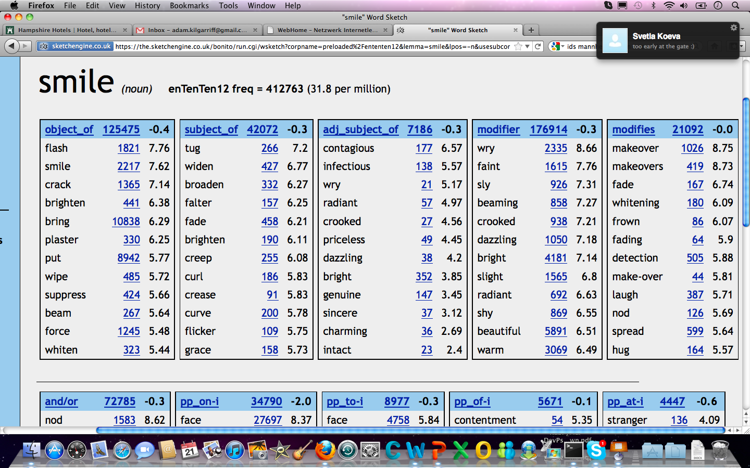

Slide 16
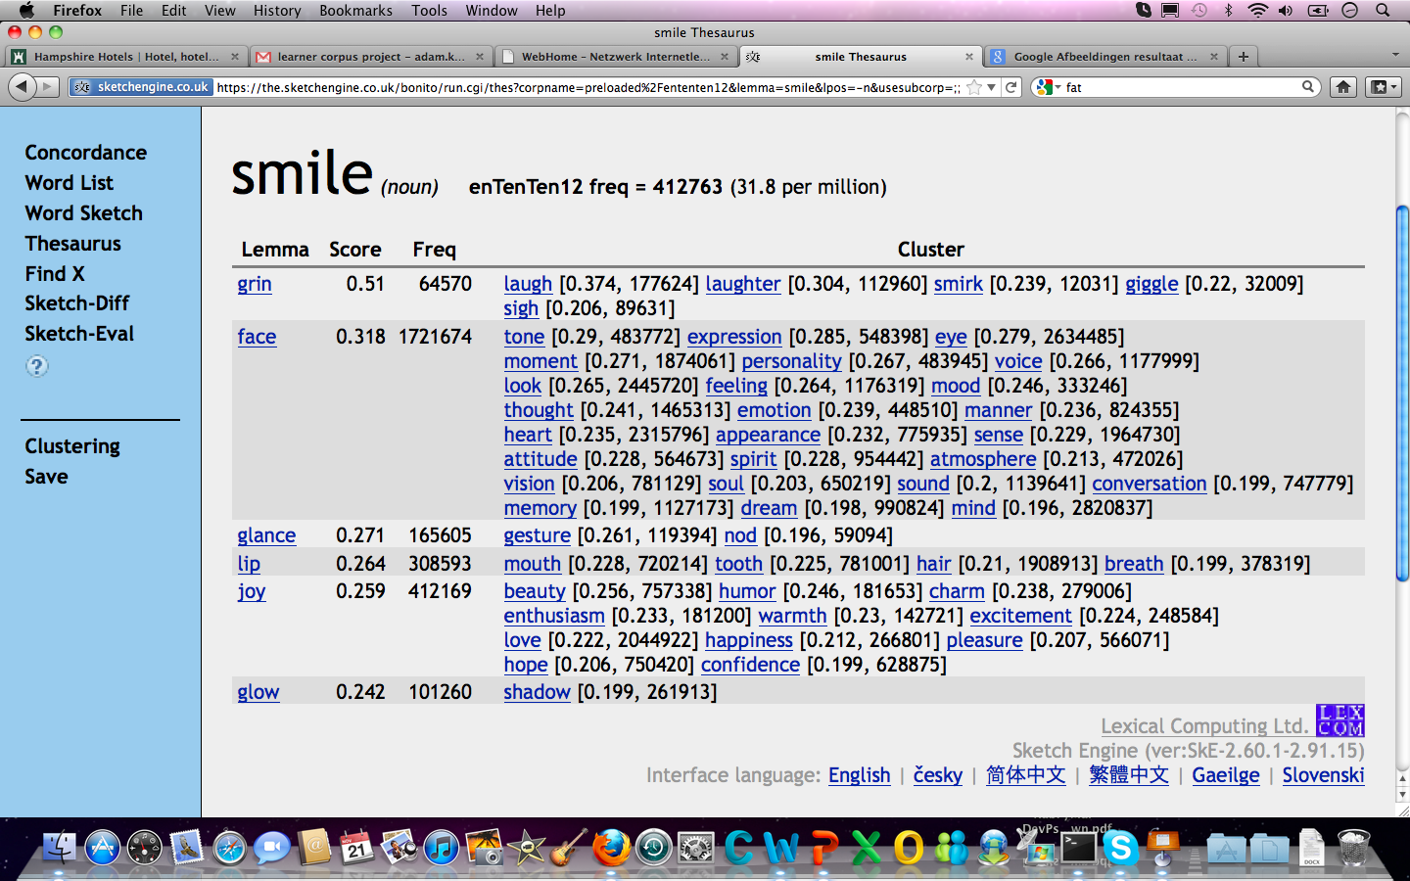

Slide 17
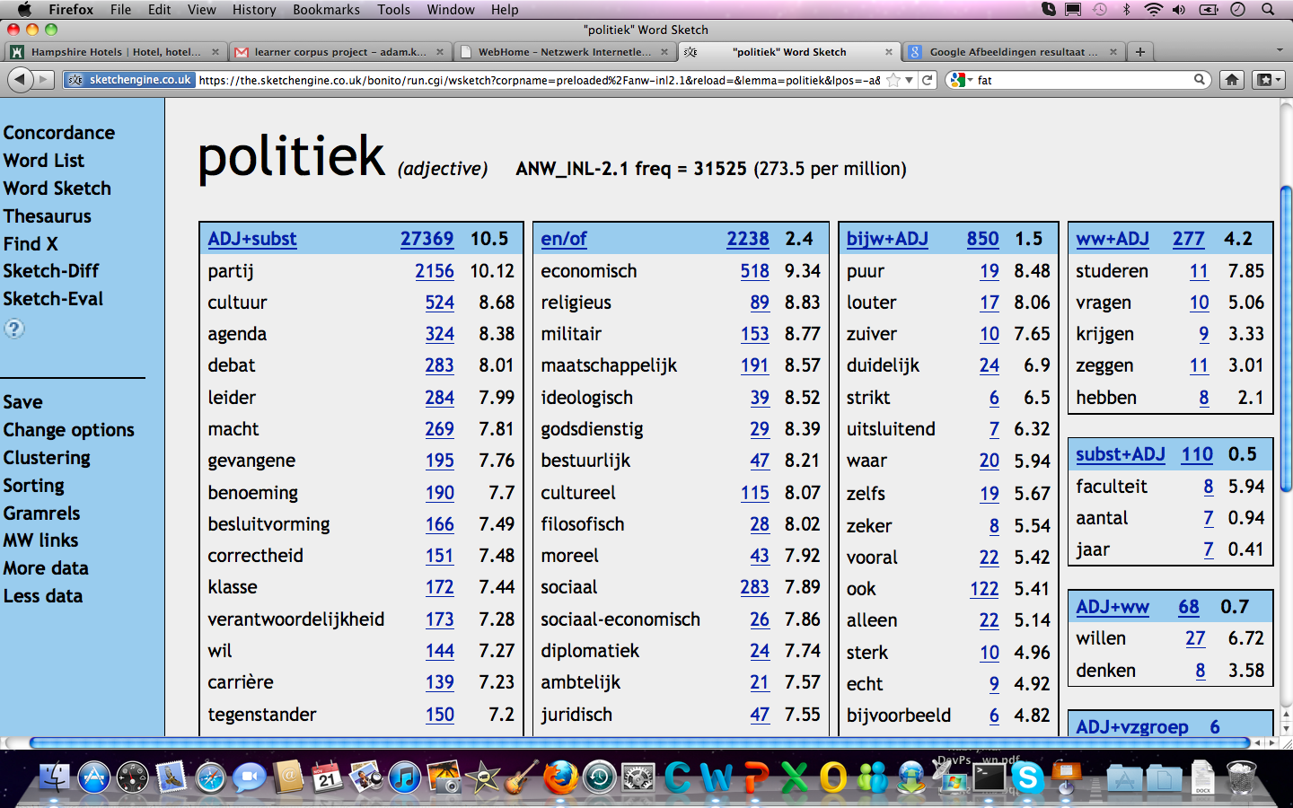

Slide 18
Where now
Core technology
In place
Front end for linguists
In place
Front end for other humanities scholars
Good prospect
Links to other resources
Preliminary work with British Library
Proposals welcome

Slide 19
Thank you
http://www.sketchengine.co.uk
adam@lexmasterclass.com

