Slide 1
Setting up for Corpus Lexicography
Adam Kilgarriff, Jan Pomikalek,
Milos Jakubicek
Lexical Computing Ltd
&
Pete Whitelock,
Oxford University Press

Slide 2
Premise
Corpus technology can support lexicography
making it
more accurate
more consistent
faster
Rundell and Kilgarriff 2011
Automating the creation of dictionaries
in Sylviane Granger’s Festschrift
This paper
A case study

Slide 3
A new Portuguese dictionary
OUP
Pt-En and En-Pt
40,000 headwords on each side
Pt-En starts from
Dictionary
Medium-sized Pt-Dutch
Corpus
blank sheet

Slide 4
Agenda
Collect corpus
Process with best tools
From parser output to corpus system input
Finding good examples
Regional variants

Slide 5
Status
Collect corpus
Process with best tools
From parser output to corpus system input
Finding good examples
Regional variants

Slide 6
Corpus collection
Big and diverse
100m not big enough
40,000 headwords
40,000th word in BNC: 27 hits

Slide 7
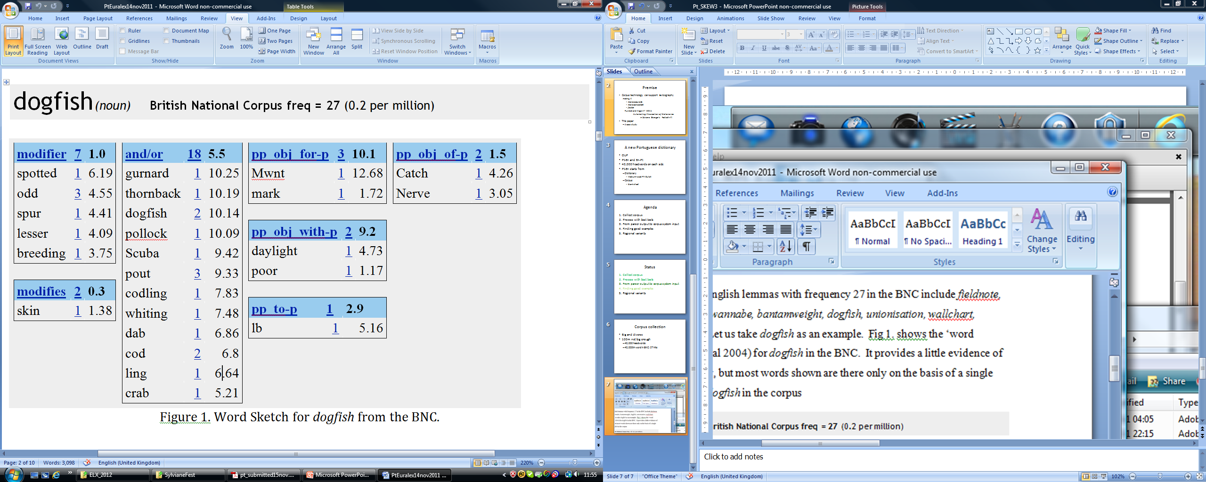

Slide 8
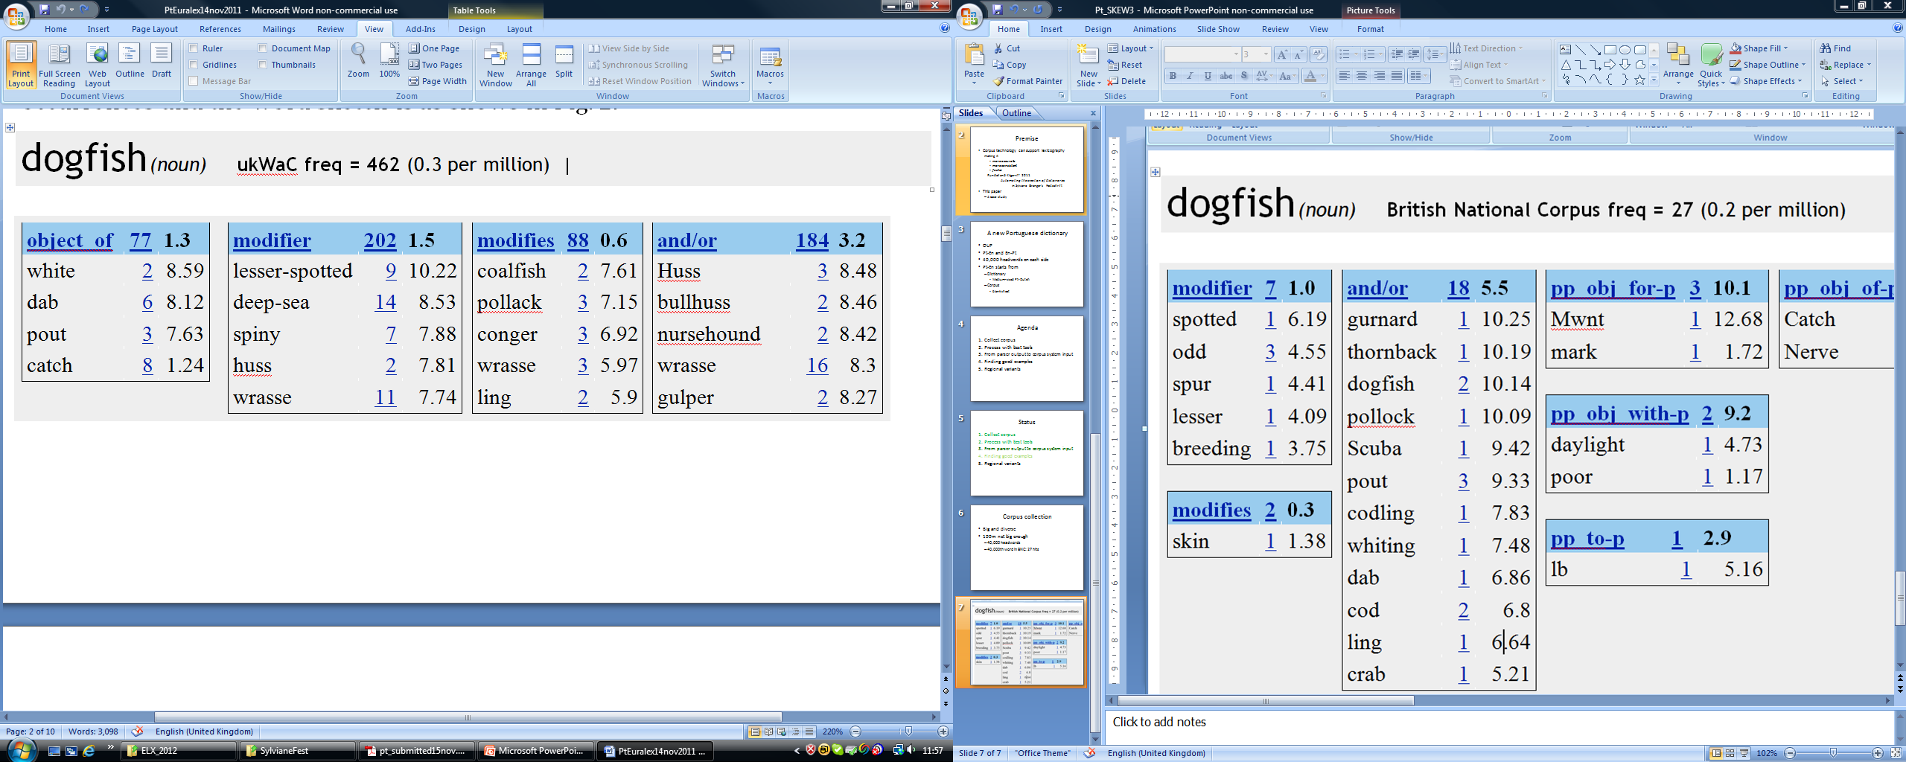

Slide 9
Where from?
Web
Quantity
Yeah
Quality
As good or better
Keller and Lapata 2003, Sharoff 2006, Baroni et al 2009

Slide 10
How?
New linguistics-specialist crawler
Was Heritrix, next time: Spiderling
A billion words a day
Cleaning including language-identification
jusText
Best system: Jan Pomikalek thesis
Deduplication
Onion
Best system: Jan Pomikalek thesis

Slide 11
Figures
 | European | Brazilian
HTML data downloaded | 1.10 TB | 1.37 TB
Unique URLs | 31.5 million | 39.1 million
Crawling time | 8 days | 10 days

Slide 12
Processing tools
Reviewed options
Best: Palavras
Eckhard Bick, 2000
+ ongoing development since
Contacted author, negotiated licence
Installed
Applied to 70 million documents

Slide 13
Vast process
Parsing is usually slow - would it take years?
Parallelised in 12 processes
Many bugs encountered, resolved with developers
Crashed on many input files – leave them out
Final run: 15 days

Slide 14
Figures
 | European | Brazilian
HTML data downloaded | 1.10 TB | 1.37 TB
Unique URLs | 31.5 million | 39.1 million
Crawling time | 8 days | 10 days
Final corpus size (words) | 0.7 billion | 1.0 billion

Slide 15
From dependency parse to word sketch
Palavras: dependency parser
Output for each word
Lemma, pos, tag
“my governor is word N”
“relation is …”
Like CONLL output
Assn Computational Linguistics Special Interest Group on Natural Language Learning
Standard form for dependency-parser output
Already used in many projects
Word sketches from CONLL format data
Already done - Siva Reddy, 2011

Slide 16
satisfação satisfação N F:S 14,V obj

Slide 17
satisfação satisfação N F:S 14,V obj
“I am the 19th word in a sentence, satisfação, my lemma is satisfação, my word class is Noun, Feminine Singular, and my governor is the verb found at word 14, with relation Object”

Slide 18
satisfação satisfação N F:S 14,V obj
“I am the 19th word in a sentence, satisfação, my lemma is satisfação, my word class is Noun, Feminine Singular, and my governor is the verb found at word 14, with relation Object”
Find verb at 14
manifestar
Add
<OBJ, manifestar, satisfação> <OBJ-OF, satisfação,manifestar>
to word sketches database

Slide 19
To get better word sketches
Parser output and lexicographic word sketches
Not quite the same
Parsing needs ‘linguistic integrity’
Lexicographic examples need ‘textual fidelity’
Occasionally: they clash
Post-processing of parser output
+ fixing some common errors
Large project (at OUP)

Slide 20
Preposition-article contractions
satisfação [satisfação] <cjt> <act> <percep-f> N F S @<ACC #19->17
de [de] <sam-> <np-close> PRP @N< #20->19
os [o] <-sam> <artd> DET M P @>N #21->23
nossos [nosso] <poss 1P> DET M P @>N #22->23
clientes [cliente] <Hattr> N M P @P< #23->20
19 satisfação satisfação N F:S 14,V obj %w_N/%w_V obj
20 dos de PRP 19,NIL/%w_N dep PRP
21 nossos nosso DET M:P 22,NIL/DET spec_of %w_N
22 clientes cliente N M:P 19,N _de_ %w_N/%w_N _de_ N

Slide 21
Verb form reconstruction
Deveria- [dever] <*> <hyfen> <fmc> <aux> V COND 3S VFIN @FS-STA #1->0
se- [se] <hyfen> PERS M/F 3S/P ACC @<SUBJ #2->1
começar [começar] <vH> <mv> V INF @ICL-AUX< #3->1
1 Dever-se-ia dever V COND:3S:VFIN 1,REFL-SUBJ
2 começar começar V INF 1,V comp %w_V/%w_V comp V

Slide 22
Multi-word unpacking
A=Comunidade=de=Direitos=Humanos [A=Comunidade=de=Direitos=Humanos] <tit> <*> PROP F P @NPHR #2->0
<mwe parsed="yes" pos="PROP">
2 A o DET F:S 3,NIL/DET spec_of %w_N
3 Comunidade comunidade N F:S
4 de de PRP 3,NIL/%w_N dep PRP
5 Direitos direito N M:P 3,N _de_ %w_N/%w_N _de_ N
6 Humanos humano ADJ M:P 5,N mod %w_ADJ/%w_N mod ADJ
</mwe>

Slide 23
Trinary Relations/Coordination
um [um] <arti> DET M S @>N #17->18
simulador [simulador] <H> N M S @<SC #18->0
de [de] <np-close> PRP @N< #19->18
inclinação [inclinação] <cjt-head> <percep-f> <am> N F S @P< #20->19
e [e] KC @CO #21->20
direção [direção] <cjt> <HH> <dir> <Ltop> N F S @P< #22->20
17 um um DET M:S 18,NIL/DET spec_of %w_N
18 simulador simulador N M:S
19 de de PRP 18,NIL/%w_N dep PRP
20 inclinação inclinação N F:S 18,N _de_ %w_N/%w_N _de_ N
21 e e KC
direção direção N F:S 18,N _de_ %w_N/%w_N _de_ N;
20,N e|ou %w_N/%w_N e|ou N

Slide 24
Control relations
não [não] ADV @ADVL> #3->4
é [ser] <vK> <fmc> <mv> V PR 3S IND VFIN @FS-STA #4->0
viável [viável] <nh> ADJ F S @<SC #5->4
sua [seu] <poss 3S> DET F S @>N #6->7
aplicação [aplicação] <act> <sem-r> N F S @<SUBJ #7->4
3 não não ADV 4,%w_ADV mod_of V/ADV mod_of %w_V
4 é ser V PR:3S:IND:VFIN 7,N subj_of %w_V/%w_N subj_of V
viável viável ADJ F:S 4,V dep %w_ADJ/%w_V dep ADJ;
7,N subj_of %w_ADJ/%w_N subj_of ADJ
6 sua seu DET F:S 7,NIL/DET spec_of %w_N
7 aplicação aplicação N F:S

Slide 25
Reanalysis
variados [variar] V PCP M P @>N #21->22
aspectos [aspecto] <cjt-head> <ac-cat> N M P @<SUBJ #22->17
de [de] <sam-> <np-close> PRP @N< #23->9
a [o] <-sam> <artd> DET F S @>N #24->25
tecnologia [tecnologia] <domain> N F S @P< #25->23
20 variados variar V PCP:M:P
21 aspectos aspecto N M:P 35,N subj_of %w_N/%w_N subj_of N
22 da de PRP 21,NIL/%w_N dep PRP
23 tecnologia tecnologia N F:S 21,N _de_ %w_N/%w_N _de_ N

Slide 26
Lemmatization
Old spelling | New spelling
acto | ato
carbónico | carbônico
cabeça-de-burro | cabeça de burro
concetual | conceptual
auto-sugestão | autossugestão
[Spelling reforms] - use Modern Brazilian as lemma
Female form | Male form
amiga | amigo
[Old chestnut] – use masculine as lemma

Slide 27
GDEX
Good dictionary example finder
Customise for Portuguese
Follow Slovene lead

Slide 28
Regional variation
European vs Brazilian
Method
Keyword list of each vs other
If in top 1%: add note to word sketch

Slide 29
Demo
http://www.sketchengine.co.uk

