Slide 1
Terminology-finding in the Sketch Engine
Miloš Jakubíček, Adam Kilgarriff,
Vojtěch Kovář, Pavel Rychlý, Vit Suchomel
Lexical Computing Ltd., Brighton, UK & Masaryk University, Brno, Czech Republic

Slide 2
Terminology
Problem #1
Finding it

Slide 3
Terminology
Problem #1
Finding it
Existing lists
Ask experts
Corpora

Slide 4
To find terms in a corpus
Unithood
For multi-word terms
Do the words form a unit?
Termhood
Does it belong to the domain?

Slide 5
Unithood
Grammar
Terms are noun phrases
(in canonical form, without the article)
Requirements
Noun phrase grammar
Prerequisites: tokeniser, lemmatiser, POS-tagger
Parsing machinery

Slide 6
Termhood
Frequency
in domain corpus vs reference corpus
Same as keywords
Requirements
Formula for keyness
Domain corpus
Reference corpus

Slide 7
In the Sketch Engine

Slide 8
Unithood
Grammar
Terms are noun phrases
(in canonical form, without the article)
Requirements
Noun phrase grammar
To date: Chinese English French Japanese Korean Spanish
In progress: German Portuguese Russian
Collaboration with experts
Prerequisites: tokeniser, lemmatiser, POS-tagger
Available/installed for languages above and several others
Parsing machinery
In place: variant on word sketches infrastructure

Slide 9
Termhood
Frequency
in domain corpus vs reference corpus
Same as keywords
Requirements
Formula for keyness
Kilgarriff 2009: Simple maths for keywords
Ratio of normalised frequencies (with simplemaths parameter
Domain corpus
Existing machinery for
Instant corpora from the web: WebBootCaT
Uploading/installing your own corpus
Reference corpus
Large web corpora: sixty languages

Slide 10
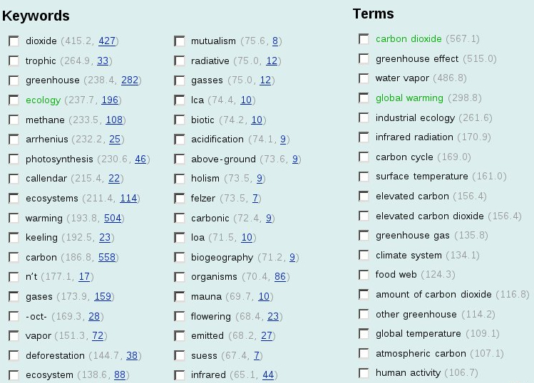
<Examples ... En, Fr, Korean>
All – what do you think looks prettiest/best
From WIPO or plain?
Mixed?
I can revisit tomorrow

Slide 11
Processing chains
Tokeniser-lemmatiser-POS-tagger
Must be identical for
Reference corpus (batch mode)
Domain corpus (runtime)
Recent work
Processing chains reviewed
Separated out for independent application

Slide 13
Current status
Lead customer
WIPO (World Intellectual Property Organisation)
terminology group of their translation dept
Five languages: delivered
Added functionality, blacklists etc
All customers
First version in beta

Slide 14
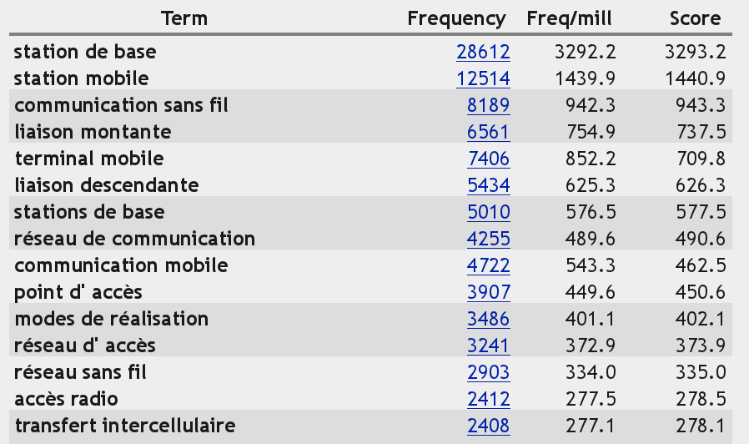

Slide 15
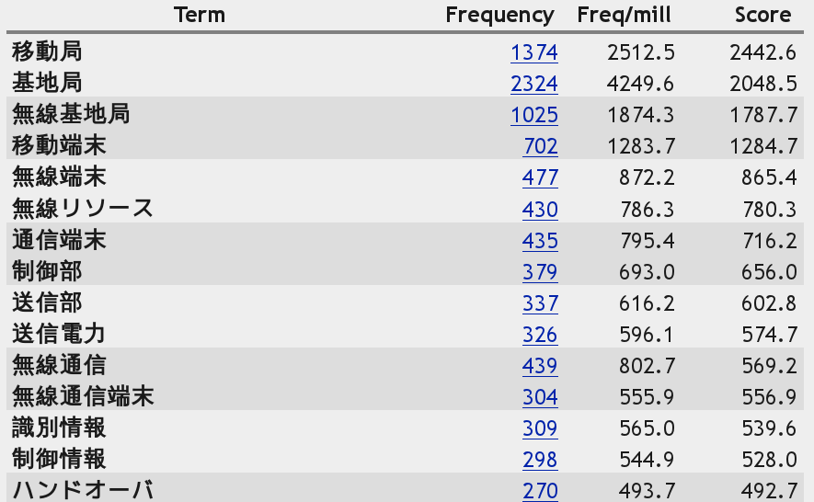

Slide 16
Current challenge
Lemmas and word forms
When to user singular, when plural
Adjective-noun agreement
nuée ardente
volcanology: Fr for pyroclastic surge
Feminine, often plural
Lemmas: nuée ardent wrong
Word forms: nuées ardentes a little bit wrong

Slide 17
Summary
Terminology-finding needs
Term grammar
Reference corpus + domain corpus
All available in Sketch Engine
Already, for
English French Chinese Japanese Korean Russian Spanish
Shortly for
German Portuguese
Others to follow as requested
All set for you to use: feedback please!

Slide 18
Thank you http://www.sketchengine.co.uk http://beta.sketchengine.co.uk

