Slide 1
Augmenting online dictionary entries with corpus data for Search Engine Optimisation
Holger Hvelplund,¹ Adam Kilgarriff,² Vincent Lannoy,¹ Patrick White³
¹IDM, Paris, France
²Lexical Computing Ltd., Brighton, England
³Oxford University Press

Slide 2
Search Engine Optimisation (SEO)
New
The art of improving search engine rankings
get to the top when a user searches ‘your’ term
If you do business on the web
Do it or die

Slide 3
Search Engine Optimisation (SEO)
New
The art of improving search engine rankings
get to the top when a user searches ‘your’ term
If you do business on the web
Do it or die
because
The more traffic, the more business
Much/most traffic arrives via Google and other SEs
Not at (or very near) top → no search engine traffic

Slide 5
SEO
Many methods
Ours:
Augment dictionary entries with
corpus-derived collocates and related words
identified in the Sketch Engine

Slide 6
The dictionary
Lannoy 2010 (Euralex paper)
Showed it worked with WordNet
Now:
Does it work with top dictionary, commercial environment?
Oxford Advanced Learners

Slide 7
Experiment
200 OALD entries
Augment
July-Sept 2013
Did these words get extra web traffic?

Slide 8
Collocates
from word sketches

Slide 9
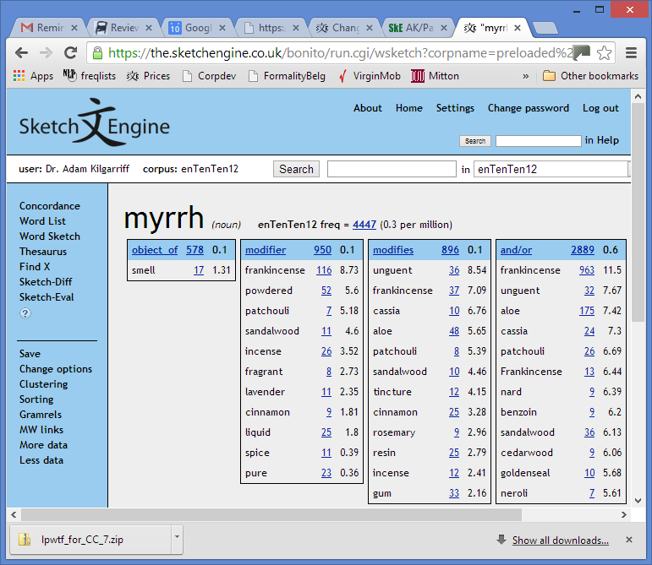
Word sketch

Slide 10
Related words
from thesaurus

Slide 11
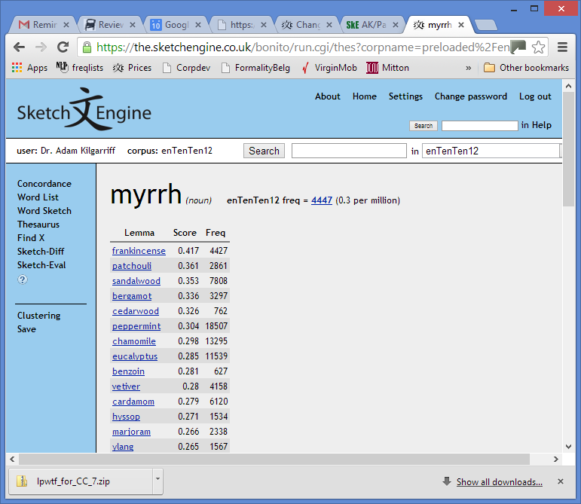

Slide 12
Sample: 231 headwords
abalone abjure abstruse adroit aerobatics aggrandizement agoraphobia ague amanuensis ammonite antonym apostate apprise arachnid arrears askance askew auburn aura autoimmune avocation azure backgammon ballpoint barbell bargaining barista bashful beanie berserk besotted bespoke beta betrothal bidet bigamy bitumen bling blinker bonkers bonsai booger brainiac brainwave burlesque ...
Low frequency

Slide 13
Method
For each headword
Look in enTenTen12
11.2 billion words of current web English
Find highest scoring collocates, related words
If they are
Collocation freq > 5, high salience
In OALD
Not already there
Up to max 20 of each
Approved (manual check)
Add them in

Slide 14
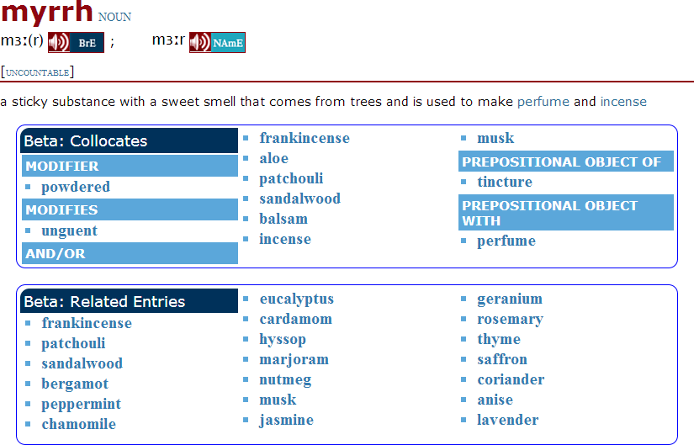

Slide 16
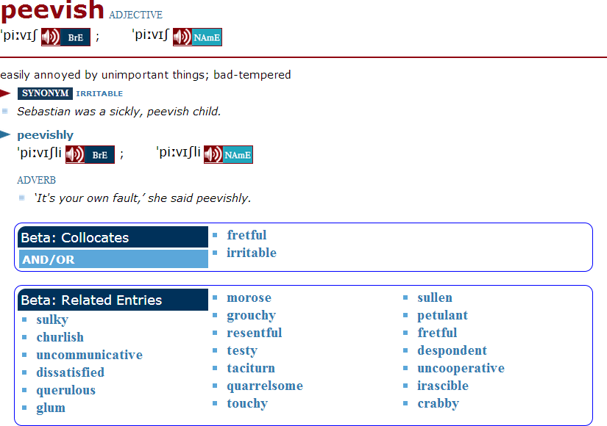

Slide 17
Editorial check
Ideally, not required
For this experiment
8-10 hours for 250 entries
3367 links automatically added ...
98 (3%) removed
Reasons
Web spam
Proper names which are also regular words

Slide 18
User feedback
Not much yet
3 months, rare words, small sample
3 unsolicited emails
From Italy
I’ve just come across the beta version panel and I think it is a great idea. I do like it and I wish I could find it as much as possible

Slide 19
from Poland
I have opened the dictionary today and saw the additions for the first time. I think it is a great idea and very useful! Both Collocates and Related Entries can help my students and myself in learning and teaching English. They are very intuitive and easy to use. I do hope you will develop this BETA version and we will be able to use more of it soon. Congratulations on great improvement!
from Spain:
I really appreciate the usefulness of the “Relative Entries” addition. I think they are a good complement that helps very much in learning vocabulary. With them it is a pleasure to relate words that in another way are difficult to find for a foreign student. I would like that, little by little, you could increase the number of entries.

Slide 20
SEO results
Comparing Jul-Sept 2013 with Jul-Sept 2012
However
So
Pageviews: 35% above average
Visits: 30% above average
Test entries | 2012 | 2013 | % change
Pageviews | 100 | 177 | 77%
Visits | 100 | 196 | 96%
All entries | 2012 | 2013 | % change
Pageviews | 100 | 142 | 42%
Visits | 100 | 166 | 66%

Slide 21
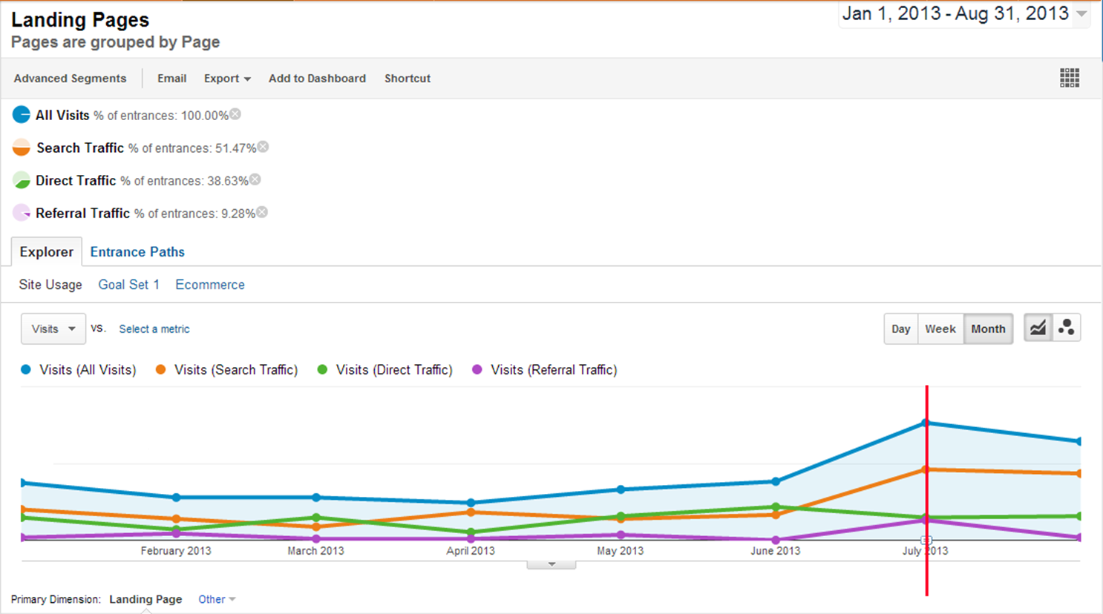

Slide 22
Significant?
Of 231 test entries
141 entries: traffic increase > OALD average
90 entries: traffic increase < OALD average
Signs test:
Null hypothesis that this was random variation
Defeated with 99% confidence
Yes

Slide 23
Corpus size
For these low-freq words
UKWAC (1.3b words) often not big enough
“But I don’t have a corpus that size”
Tenten family of corpora
Multi-billion words, web-crawled
Available in Sketch Engine for all major world languages
More languages following

Slide 24
Next steps
Spam filtering when corpus building
Spam filtering of collocates related words
So editorial phase not needed

Slide 25
Conclusion
SEO: critical for online dictionaries
One method
Augment entries with corpus-derived collocates and related words
Experiment
OALD, 231 entries, July-Sept 2013
Enthusiastic users
SEO, Web traffic, substantially increased
Do it

Slide 26
Thank you

