Slide 1
What's on the Web? The Web as a Linguistic Corpus
Adam Kilgarriff
Lexical Computing Ltd
University of Leeds

Slide 2
You can’t help noticing
Replaceable or replacable?
http://googlefight.com

Slide 3
What is a corpus?
A collection of texts
Call it a corpus when
Used for literary or linguistic research

Slide 4
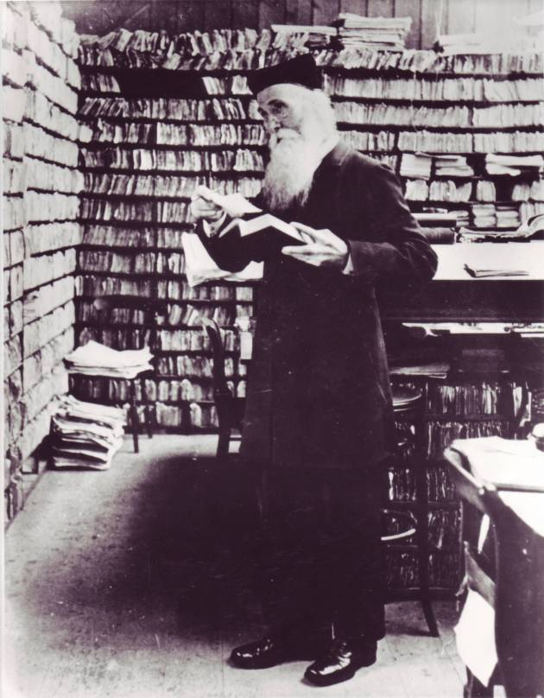
History

Slide 5
Corpora since the 1960s
10⁹
10⁸
10⁷
10⁶
Size
(in words)
1960s 1970s 1980s 1990s 2000s
Brown/LOB COBUILD BNC OEC

Slide 6
Pioneers
Dictionary publishers
Most words rare: must be vast
Other interested parties
Mostly for word frequency lists:
Educationalists
Psychologists
Since 1990s
Language technology

Slide 7
Corpus types
Monolingual
Parallel
Bi-texts: a text and its translation
Statistical machine translation
Google translate
Comparable
More than one language, same kind of text for each

Slide 8
Parameters
Language
Size
A thousand to a trillion words
1,000 to 1,000,000,000,000
words, sentences, GB, hours
Text type
Writing, speech
Newspaper, blog, chat, academic, …, mixed
Sport, hairdressing, DNA of the nematode worm

Slide 9
The Web
Very very large
2006 estimates for duplicate free, linguistic, Google-indexed web
German: 44 billion words
Italian: 25 billion words
English: 1 -10 trillion words
Most languages
Most language types
Up-to-date
Free
Instant access

Slide 10
What is out there?
What text types are there on the web?
some are new: chatroom
proportions
is it overwhelmed by porn? How much?
Hard question
Notes:
10

Slide 11
Comparing frequency lists
Web1T
Present from Google
All 1-, 2-, 3-, 4, 5-grams with f>40 in one trillion words of English
Compare with British National Corpus
100m words
Early 1990s: pre-web
Keywords of each vs. other
Highest contrast of frequency

Slide 12
Web-high (155 terms)‏
61 web and computing
config browser spyware url www forum
38 porn
22 US English (incl Spanish influence –los)‏
18 business/products common on web
poker viagra lingerie ringtone dvd casino rental collectible tiffany
NB: BNC is old
4 legal
trademarks pursuant accordance herein

Slide 13
BNC-high
Exclude British English, transcription/tokenisation anomalies
herself stood seemed she looked yesterday sat considerable had council felt perhaps walked round her towards claimed knew obviously remained himself he him

Slide 14
Observations
Pronouns and past tense verbs
Fiction
Masc vs fem
Yesterday
Probably daily newspapers
Constancy of ratios:
He/him/himself
She/her/herself

Slide 15
Corpus Factory
Most languages: no large corpora
Goal
100 biggest languages, 100m-word corpora
BootCat method
Repeat 50,000 times
Seeds words
Send to a search engine
In random pairs, threes or fours
Collect the pages the search engine finds
Seed words from wikipedia

Slide 16
42 Languages
Arabic Bengali Bulgarian Chinese Croatian Czech Danish Dutch English Estonian Finnish French German Greek Gujarati Hebrew Hindi Indonesian Irish Italian Japanese Korean Malay Malayalam Maltese Norwegian Persian Polish Portuguese Romanian Russian Serbian Slovene Spanish Swahili Swedish Tamil Telugu Thai Turkish Vietnamese Welsh

Slide 17
Corpus quality
Character encoding
‘boilerplate’
Navigation bars, adverts, legal disclaimers, …
Duplicates
Language
Contamination by English
Concerns shared by by Google, Microsoft, IBM etc
LCL use (and develop) leading methods

Slide 18
Levels of processing
Lemmas and word forms
Invade vs invade invaded invades invaded
Part-of-speech tagging
Also word-class tagging
brush (verb) (“she brushed him aside”) vs. brush (noun) (“Give me the brush.”)
can (verb) (“he can do it”) vs. can (noun) (“the beer can”)
Some languages, not others

Slide 19
Demo

