Slide 1
Measuring Distance between Language Varieties
Adam Kilgarriff, Jan Pomikalek, Pavel Rychly, Vit Suchomel
Supported by EU Project PRESEMT

Slide 2
How to compare language varieties
Qualitative
Quantitative
Quantitative means corpus
Corpus represents variety
Compare corpora

Slide 3
My big question
How to compare corpora
How else can corpus methods/corpus linguistics be scientific
Roles
How do varieties contrast
How do corpora contrast
When we don’t know if they are different
Find bugs in corpus construction

Slide 4
Corpus comparison
Qualitative
Quantitative

Slide 5
Qualitative
Take keyword lists
[a-z]{3,}
Lemma if lemmatisation identical, else word
C1 vs C2, top 100/200
C2 vs C1, top 100/200
study

Slide 6
Qualitative: example, OCC and OEC
OEC: general reference corpus
OCC: writing for children
Look at fiction only
Top 200 keywords (each way)
what are they?

Slide 8
Do it
Sketch Engine does the grunt work
It’s ever so interesting

Slide 9
Quantitative
Methods, evaluation
Kilgarriff 2001, Comparing Corpora, Int J Corp Ling
Then:
not many corpora to compare
Now:
Many
Ad hoc, from web
First question: is it any good, how does it compare
Let’s make it easy: offer it in Sketch Engine

Slide 10
Original method
C1 and C2:
Same size, by design
Put together, find 500 highest freq words
For each of these words
Freqs: f1 in C1, f2 in C2, mean=(f1+f2)/2
(f1-f2)²/mean (chi-square statistic)
Sum
Divide by 500: CBDF

Slide 11
Evaluated
Known-similarity corpora
Shows it worked
Used to set parameter (500)
CBDF better than alternative measures tested

Slide 12
Adjustments for SkE
Problem: non-identical tokenisation
Some awkward words: can’t
undermine stats as one corpus has zero
Solution
commonest 5000 words in each corpus
intersection only
commonest 500 in intersection

Slide 13
Adjustments for SkE
Corpus size highly variable
Chi-square not so dependable
Also not consistent with our keyword lists
Link to keyword lists – link quant to qual
Keyword lists
nf = normalised (per million) frequencies
Keyword lists: nf1+k/nf2+k
Default value for k=100
We use: if nf1>nf2, nf1+k/nf2+k, else nf2+k/nf1+k
Evaluated on Known-Sim Corpora
as good as/better than chi-square

Slide 15
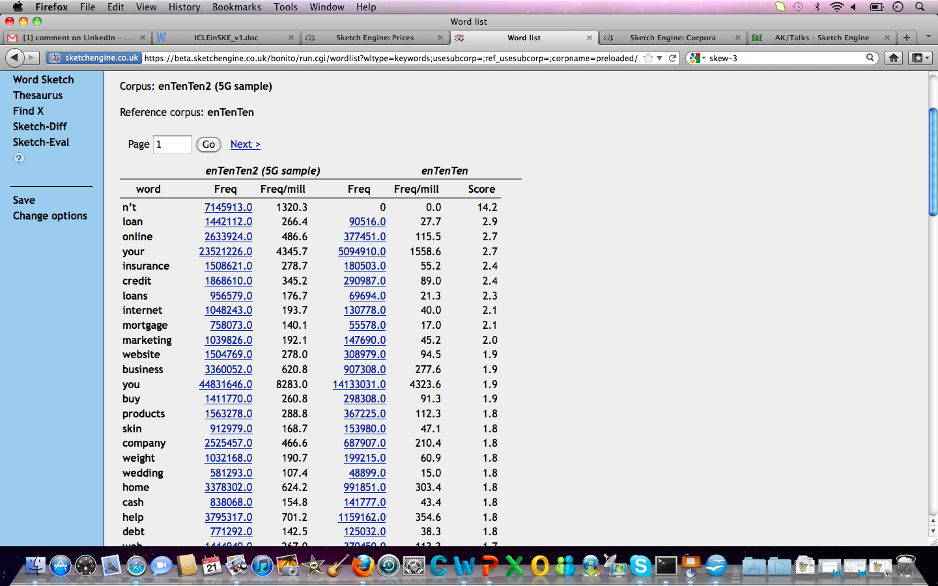
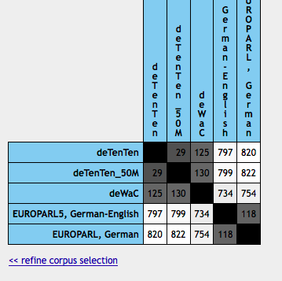

Slide 16
What’s missing
Heterogeneity
“how similar is BNC to WSJ”?
We need to know heterogeneity before we can interpret
The leading diagonal
2001 paper: randomising halves
Inelegant and inefficient
Depended on standard size of document

Slide 17
New definition, method (Pavel)
Heterogeneity (def)
Distance between most different partitions
Cluster to find ‘most different partitions’
Bottom-up clustering
until largest cluster has over one third of data
Rest: the other partition
Problem
nxn distance matrix where n > 1 million
Solution: do it in steps

Slide 18
Summary
Corpus comparison
Qualitative: use keywords
Quantitative
On beta
Heterogeneity (to complete the task) to follow (soon)

Slide 19
Simple maths for keywords This word is twice as common in this text type as that
 | N | freq | Freq per m
Focus Corp | 2m | 80 | 40
Ref corp | 15m | 300 | 20
ratio |  |  | 2

Slide 20
Intuitive
Nearly right but:
How well matched are corpora
Not here
Burstiness
Not here
Can’t divide by zero
Commoner vs. rarer words

Slide 21
You can’t divide by zero
Standard solution: add one
Problem solved
 | fc | rc | ratio
buggle | 10 | 0 | ?
stort | 100 | 0 | ?
nammikin | 1000 | 0 | ?
 | fc | rc | ratio
buggle | 11 | 1 | 11
stort | 101 | 1 | 101
nammikin | 1001 | 1 | 1001

Slide 22
High ratios more common for rarer words
 | fc | rc | ratio | interesting?
spug | 10 | 1 | 10 | no
grod | 1000 | 100 | 10 | yes
some researchers: grammar, grammar words
some researchers: lexis content words
No right answer
Slider?

Slide 23
Solution: don’t just add 1, add n
n=1
n=100
word | fc | rc | fc+n | rc+n | Ratio | Rank
obscurish | 10 | 0 | 11 | 1 | 11.00 | 1
middling | 200 | 100 | 201 | 101 | 1.99 | 2
common | 12000 | 10000 | 12001 | 10001 | 1.20 | 3
word | fc | rc | fc+n | rc+n | Ratio | Rank
obscurish | 10 | 0 | 110 | 100 | 1.10 | 3
middling | 200 | 100 | 300 | 200 | 1.50 | 1
common | 12000 | 10000 | 12100 | 10100 | 1.20 | 2

Slide 24
Solution
n=1000
Summary
word | fc | rc | fc+n | rc+n | Ratio | Rank
obscurish | 10 | 0 | 1010 | 1000 | 1.01 | 3
middling | 200 | 100 | 1200 | 1100 | 1.09 | 2
common | 12000 | 10000 | 13000 | 11000 | 1.18 | 1
word | fc | rc | n=1 | n=100 | n=1000
obscurish | 10 | 0 | 1st | 2nd | 3rd
middling | 200 | 100 | 2nd | 1st | 2nd
common | 12000 | 10000 | 3rd | 3rd | 1st

