Slide 1
Using Corpora for Teaching Chinese
Dr. Adam Kilgarriff
Lexical Computing Ltd
Leeds University
UK

Slide 2
The argument
English
  Biggest language-teaching market
  For thirty years
    Corpora
  We have learnt how to use them
Chinese
  Learn from English

Slide 3
Global politics
My son Boris’s history course
  The American century
  The 20th Century
The 21st century
  Chinese?
  Economics
  Culture
    Confucius Institutes (孔子學院), 2004

Slide 4
The role of corpora in language teaching
Word lists
Dictionaries
Textbooks
In the classroom

Slide 5
Word lists
Define a syllabus
Define different levels of competence
Testing

Slide 6
“What words shall we teach?”
Guess
Copy
Count
  Teach the commonest

Slide 7
English word lists
Since 1940s
  For US school teaching
    Thorndike and Lorge, 1944
  For English as a Foreign Language
    West’s General Service List, 1953
      Very well done
      Dominant until recently
  Early 1990s: British National Corpus
    My lists (1995)
      200 downloads per month ever since

Slide 8
Kelly project
    European Union Lifelong Learning Program
“Word cards”
  Nine languages
    4 big languages
      Arabic Chinese English Russian
    5 smaller
      Greek Italian Norwegian Polish Swedish
  Word cards for all 36 pairs
  Which words? use corpora

Slide 9
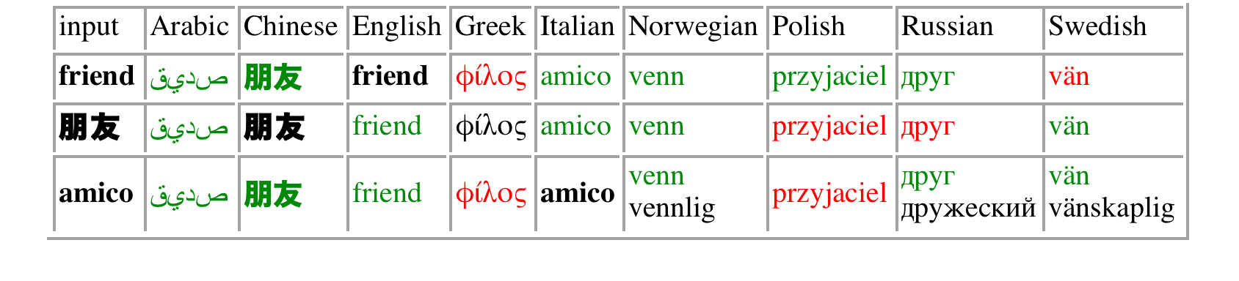
Kelly database
http://kelly.sketchengine.co.uk
Nine-language cliques (English members):
hospital library music sun theory

Slide 10
Dictionaries
What words to include
  (word lists)
  and
What to say about them
COBUILD project (1980s)
  If you do not use corpora
    you distort
  Everyone accepts

Slide 11
Learners need
Phraseology, collocations
  Find in corpora
    See brochure
  Put into dictionaries
examples
  From corpora, or they distort

Slide 12
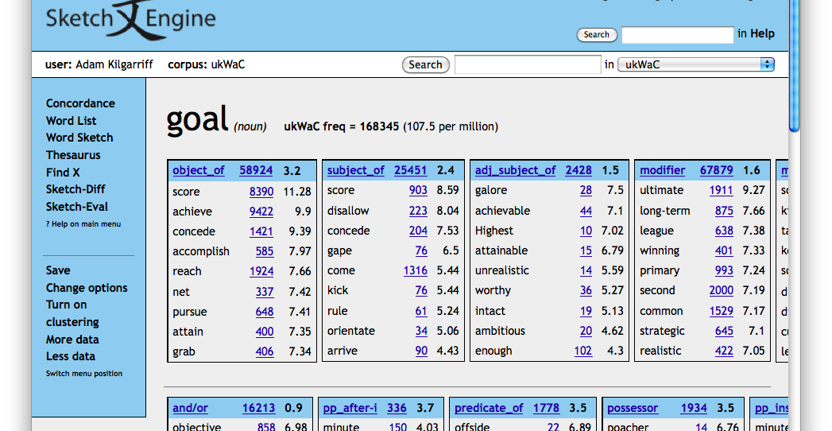

Slide 13
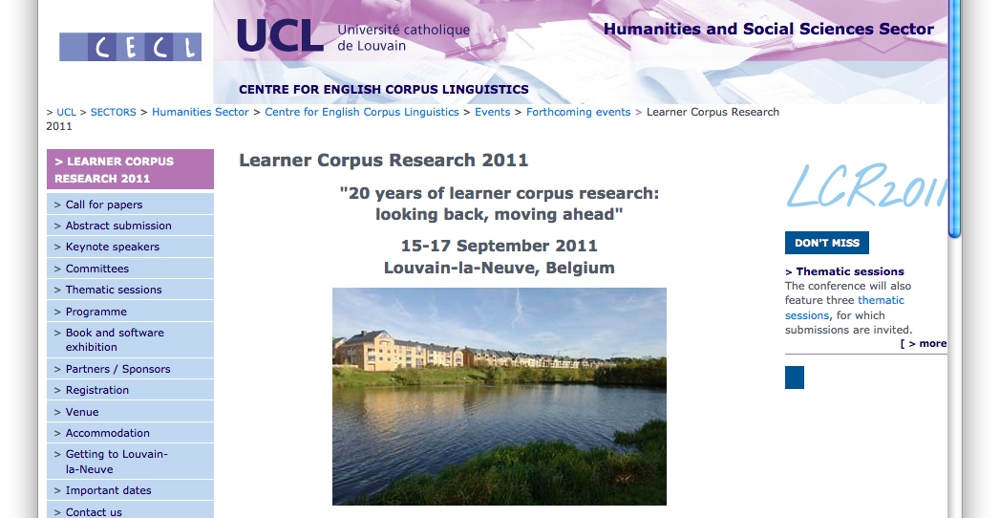
Learner corpora

Slide 14
Learner corpora
Find out what learners do
  Strengths
  Weaknesses
  At different levels
Longitudinal
  How learner learns over time

Slide 15
Course design, textbooks
Make sure what you teach is true
Teach commonest things first

Slide 16
Example: English verbs
Which is commonest form/tense
  Base
    play “let’s play football”
  -ing
    playing “I’m playing with my friends”
  Past
    played “He played well yesterday”
  Past participle
    played “We’ve played six times”

Slide 17
In the classroom
“Data driven learning”
  Tom Johns, Birmingham
Students look at concordances
    Discover language facts for themselves
  It’s tough
    Concordances are not easy to read
  Motivated, advance learners
Simon Smith, “build your own corpus”
  Uses WebBootCaT, Sketch Engine

Slide 18
The role of corpora in teaching Chinese
Word lists ?
  No (but see McEnery and Xiao)
Dictionaries ?
  Just very recently
Textbooks ?
  no
In the classroom ?
  Simon Smith, courses using Sketch Engine

Slide 19
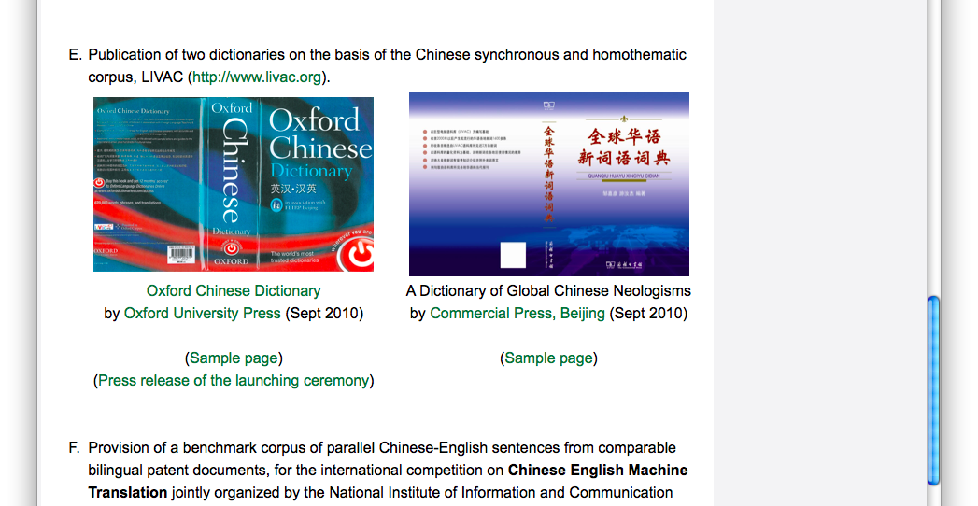

Slide 20
Chinese corpora
Newspaper
  Gigawords
    From 2003 with updates
    Simp and Trad
  LIVAC
    Live updates
Web corpora

Slide 21
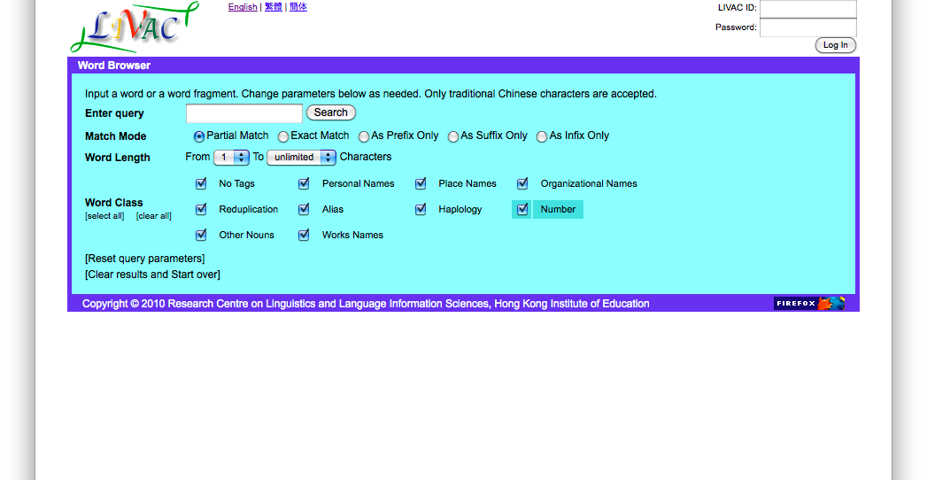
LIVAC, Hong Kong http://livac.org/

Slide 22
Web Corpora
From Lexical Computing
Brand new
Simplified
  zhTenTen; 2.1 billion words
Traditional
  TaiwanWaC; 100m words
Segemented using Stanford Univ tools

Slide 23
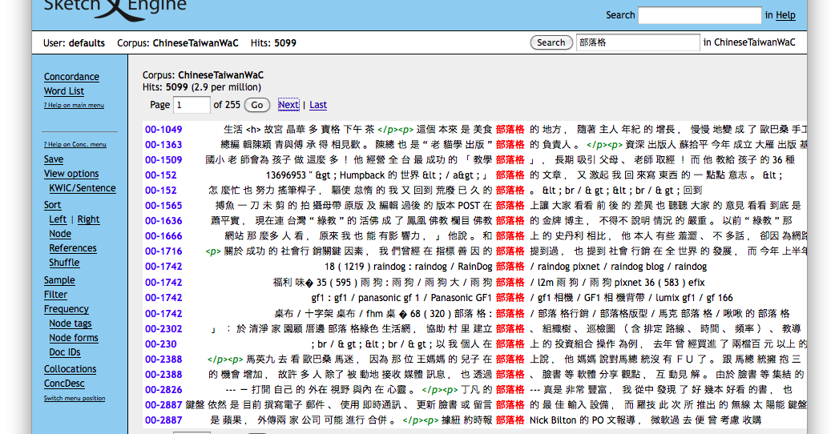
部落格

