Slide 1
Using Corpora for Teaching Chinese
Dr. Adam Kilgarriff
Lexical Computing Ltd
Leeds University
UK

Slide 2
The argument
English
Biggest language-teaching market
For thirty years
Corpora
We have learnt how to use them
Chinese
Learn from English

Slide 3
Global politics
My son Boris’s history course
The American century
The 20th Century
The 21st century
Chinese?
Economics
Culture
Confucius Institutes (孔子學院), 2004

Slide 4
The role of corpora in language teaching
Word lists
Dictionaries
Textbooks
In the classroom

Slide 5
Word lists
Define a syllabus
Define different levels of competence
Testing

Slide 6
“What words shall we teach?”
Guess
Copy
Count
Teach the commonest

Slide 7
English word lists
Since 1940s
For US school teaching
Thorndike and Lorge, 1944
For English as a Foreign Language
West’s General Service List, 1953
Very well done
Dominant until recently
Early 1990s: British National Corpus
My lists (1995)
200 downloads per month ever since

Slide 8
Kelly project
European Union Lifelong Learning Program
“Word cards”
Nine languages
4 big languages
Arabic Chinese English Russian
5 smaller
Greek Italian Norwegian Polish Swedish
Word cards for all 36 pairs
Which words? use corpora

Slide 9
Kelly database
http://kelly.sketchengine.co.uk
Nine-language cliques (English members):
hospital library music sun theory

Slide 10
Dictionaries
What words to include
(word lists)
and
What to say about them
COBUILD project (1980s)
If you do not use corpora
you distort
Everyone accepts

Slide 11
Learners need
Phraseology, collocations
Find in corpora
See brochure
Put into dictionaries
examples
From corpora, or they distort

Slide 13
Course design, textbooks
Make sure what you teach is true
Teach commonest things first

Slide 14
Example: English verbs
Which is commonest form/tense
Base
play “let’s play football”
-ing
playing “I’m playing with my friends”
Past
played “He played well yesterday”
Past participle
played “We’ve played six times”

Slide 15
In the classroom
“Data driven learning”
Tom Johns, Birmingham
Students look at concordances
Discover language facts for themselves
It’s tough
Concordances are not easy to read
Motivated, advance learners
Simon Smith, “build your own corpus”
Uses WebBootCaT, Sketch Engine

Slide 16
The role of corpora in teaching Chinese
Word lists ?
No (but see McEnery and Xiao)
Dictionaries ?
Just very recently
Textbooks ?
no
In the classroom ?
Simon Smith, courses using Sketch Engine

Slide 18
Chinese corpora
Newspaper
Gigawords
From 2003 with updates
LIVAC
Live updates
Web corpora

Slide 19
LIVAC, Hong Kong http://livac.org/

Slide 20
Web Corpora
From Lexical Computing
Brand new
zhTenTen; 2.1 billion words
Segemented using Stanford Univ tools

Slide 21
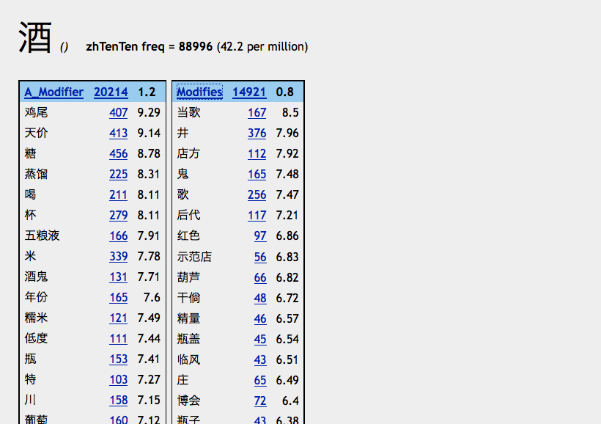
部落格

Slide 22
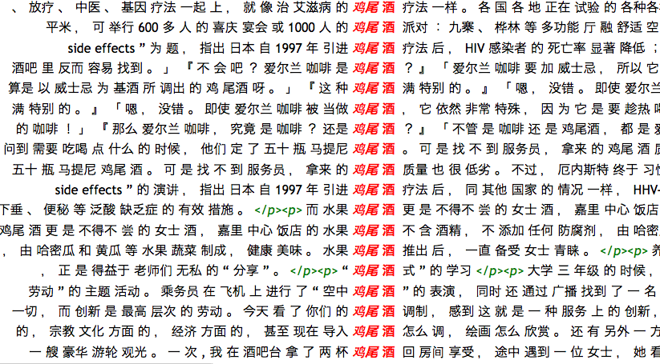

Slide 23
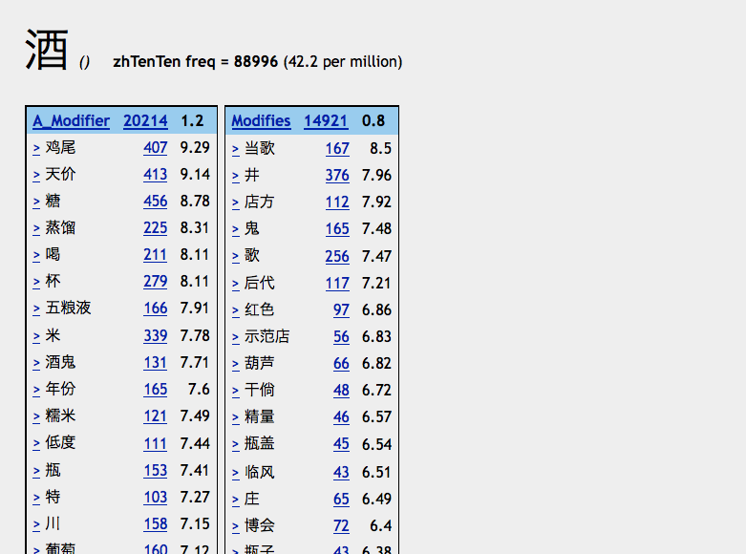

Slide 25
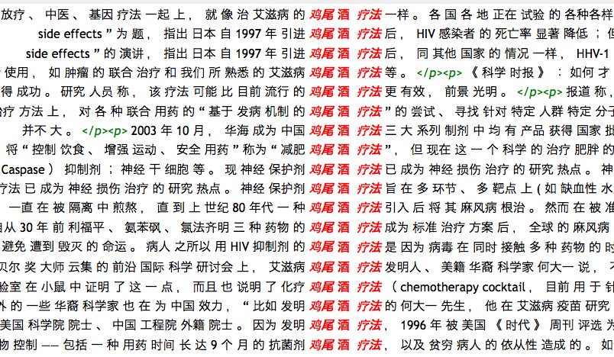

Slide 26
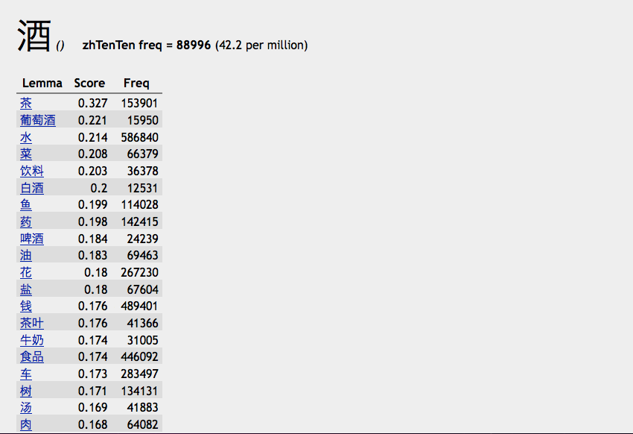

Slide 27
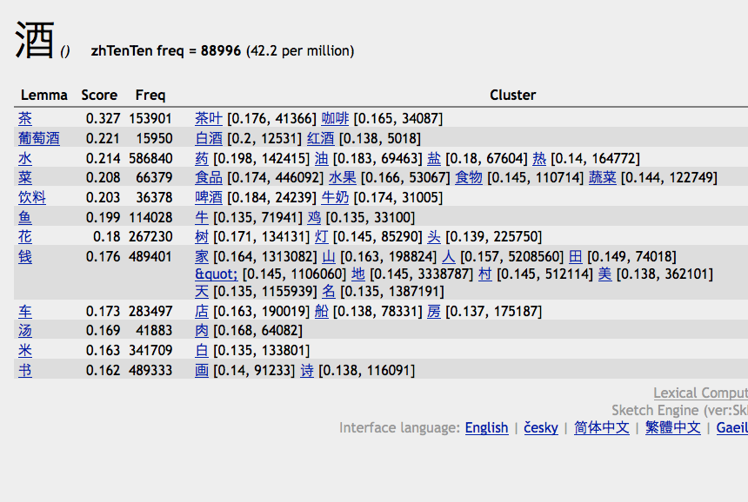

Slide 28
