Slide 1
So much of everything
Adam Kilgarriff
Lexical Computing Ltd

Slide 2
To the web on its thirteenth birthday
Teenager now, growth spurts wild and luxuriant, Your gangling form changes month on month. Born from the womb of academe in 1994 Pornography was your wetnurse Growing you big and strong Teaching you new tricks (webcams, streaming video, cash payments) that your parents never dreamed of.
Teenagers must have independence! So Web-2.0 has arrived. Now everybody feeds you.

Slide 3
New life for democracy - are you aren't you? - are you aren't you? Giving voice to millions or cancer Spam spammer spamming Phishing, viruses, Trojans Appropriating mutating multiplying. New life or cancer? Both of course Like nuclear physics and the Russian Revolution. You are huge like Exxon, Zeus and China We tremble and we lick our lips as we watch you grow.
AK 2007

Slide 4
Changes
Then
Now
Documents
Library
Passive
Information
Computer
Public
+ social media, audio, video
+ phone exchange, marketplace
+ Active
+ Interaction
+ tablet, smartphone
+ degrees of privacy

Slide 5
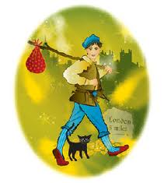

Slide 6
Dick Whittington off to London where the streets are paved with gold to make his fortune

Slide 7
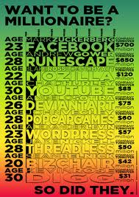
Dick Whittington off to London where the streets are paved with gold to make his fortune

Slide 8
Hero or Villain

Slide 9
Hero or Villain

Slide 10
As linguists we can
Study the web
new
fascinating
mostly language: we are well-placed
Use the web as infrastructure
Click and get it
Use the web as a source of data
All important: all different

Slide 11
Sketch Engine
Online corpus query tool
Ready-to-use corpora
All major world languages
Many others
Install your own corpora
Build corpora from the web

Slide 12
Language varieties
Get a corpus
How does it compare with a reference
Qualitatively
Quantitatively
Biber 1988: Variation in Speech and Writing

Slide 13
Qualitative
Take keyword lists
[a-z]{3,}
Lemma if lemmatisation identical, else word
C1 vs C2, top 100/200
C2 vs C1, top 100/200
study

Slide 14
Example: OCC and OEC
OEC: general reference corpus
BrE and AmE
All 21st century
Some fiction
OCC: writing for children
Most BrE
Some 21st century, some earlier
Most fiction
Compare 21st century fiction subcorpora
(not enough British 21st cent fiction on OEC)

Slide 18
It’s ever so interesting
Do it

Slide 19
Simple maths for keywords “This word is twice as common here as there”

Slide 20
“This word is twice as common here as there”
What does it mean?
For word wubble
Ratio=2:
wubble is twice as common in fc as rc
 | Freq (f) | Corp Size | Per million
Focus corp (fc) | 40 | 10m | 4
Reference corp (rc) | 50 | 25m | 2

Slide 21
“This word is twice as common here as there”
Not just words
Grammatical constructions
Suffixes
…
Keyword list
Calculate ratio for all words
Sort
Keywords: at top of list

Slide 22
Good enough for keywords?
Almost, but
Are corpora well matched?
Burstiness
You can’t divide by zero
High ratios more common for rare words

Slide 23
1 Are corpora well matched?
Proportionality
If fiction contains more American, newspaper more British…
genre compromised by region
Usual problem
Issue in corpus design
Not here

Slide 24
2 Burstiness
Word | BNC freq | BNC files
mucosa | 1031 | 9
theology | 1032 | 230
unfortunate | 1031 | 648
Discount frequency for bursty words
Gries, CL 2007, also CL journal
We use ARF (average reduced frequency)
Not here

Slide 25
3 You can’t divide by zero
Standard solution: add one
Problem solved
 | fc | rc | ratio
buggle | 10 | 0 | ?
stort | 100 | 0 | ?
nammikin | 1000 | 0 | ?
 | fc | rc | ratio
buggle | 11 | 1 | 11
stort | 101 | 1 | 101
nammikin | 1001 | 1 | 1001

Slide 26
4 High ratios more common for rarer words
 | fc | rc | ratio | interesting?
spug | 10 | 1 | 10 | no
grod | 1000 | 100 | 10 | yes
some researchers: grammar, grammar words
some researchers: lexis content words
No right answer
Slider?

Slide 27
Solution
Don’t just add 1, add n: n=1
n=100
word | fc | rc | fc+n | rc+n | Ratio | Rank
obscurish | 10 | 0 | 11 | 1 | 11.00 | 1
middling | 200 | 100 | 201 | 101 | 1.99 | 2
common | 12000 | 10000 | 12001 | 10001 | 1.20 | 3
word | fc | rc | fc+n | rc+n | Ratio | Rank
obscurish | 10 | 0 | 110 | 100 | 1.10 | 3
middling | 200 | 100 | 300 | 200 | 1.50 | 1
common | 12000 | 10000 | 12100 | 10100 | 1.20 | 2

Slide 28
Solution
n=1000
Summary
word | fc | rc | fc+n | rc+n | Ratio | Rank
obscurish | 10 | 0 | 1010 | 1000 | 1.01 | 3
middling | 200 | 100 | 1200 | 1100 | 1.09 | 2
common | 12000 | 10000 | 13000 | 11000 | 1.18 | 1
word | fc | rc | n=1 | n=100 | n=1000
obscurish | 10 | 0 | 1st | 2nd | 3rd
middling | 200 | 100 | 2nd | 1st | 2nd
common | 12000 | 10000 | 3rd | 3rd | 1st

Slide 29
But what about
Mutual information
Log-likelihood
Chi-square
Fisher’s test
…
Don’t they use cleverer maths?

Slide 30
Yes but
Clever maths is for hypothesis testing
Can you defeat null hypothesis?
Language is not random, so
… you always can
Null hypothesis never true
Hypothesis-testing not informative
Clever maths irrelevant
Kilgarriff 2006, CLLT

Slide 31
Moreover…
just one answer
grammar words vs content words?
does not help
confuses and obscures

Slide 32
Example
BAWE
British Academic Written English
Nesi and Thompson, completed last year
Student essays
Arts/Humanities, Social Sciences, Life Sciences, Physical Sciences
fc: ArtsHum, rc: SocSci
With n=10 and n=1000

Slide 35
Quantitative
Methods, evaluation
Kilgarriff 2001, Comparing Corpora, Int J Corp Ling
Then:
not many corpora to compare
Now:
Many
Ad hoc, from web
First question: is it any good, how does it compare
Let’s make it easy: offer it in Sketch Engine

Slide 36
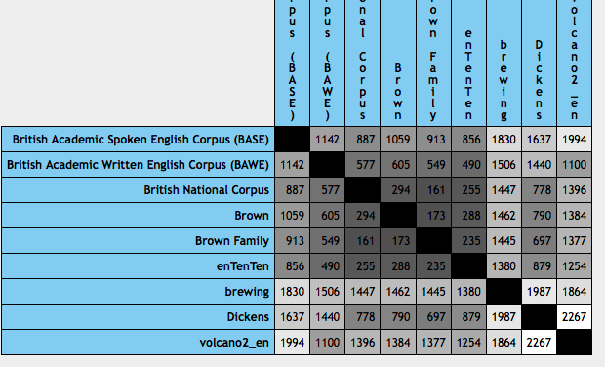

Slide 37
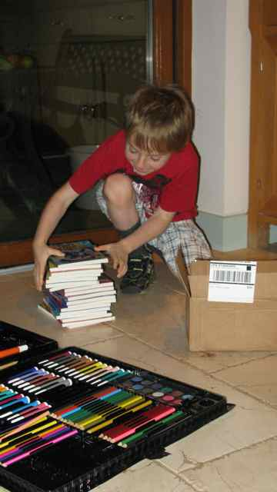
A digital native
who still likes books and crayons
Thank you

Slide 38
Original method
C1 and C2:
Same size, by design
Put together, find 500 highest freq words
For each of these words
Freqs: f1 in C1, f2 in C2, mean=(f1+f2)/2
(f1-f2)²/mean (chi-square statistic)
Sum
Divide by 500: CBDF

Slide 39
Evaluated
Known-similarity corpora
Shows it worked
Used to set parameter (500)
CBDF better than alternative measures tested

Slide 40
Adjustments for SkE
Problem: non-identical tokenisation
Some awkward words: can’t
undermine stats as one corpus has zero
Solution
commonest 5000 words in each corpus
intersection only
commonest 500 in intersection

Slide 41
Adjustments for SkE
Corpus size highly variable
Chi-square not so dependable
Also not consistent with our keyword lists
Link to keyword lists – link quant to qual
Keyword lists
nf = normalised (per million) frequencies
Keyword lists: nf1+k/nf2+k
Default value for k=100
We use: if nf1>nf2, nf1+k/nf2+k, else nf2+k/nf1+k
Evaluated on Known-Sim Corpora
as good as/better than chi-square

Slide 42
Simple maths for keywords This word is twice as common in this text type as that
 | N | freq | Freq per m
Focus Corp | 2m | 80 | 40
Ref corp | 15m | 300 | 20
ratio |  |  | 2

Slide 43
Intuitive
Nearly right but:
How well matched are corpora
Not here
Burstiness
Not here
Can’t divide by zero
Commoner vs. rarer words

Slide 44
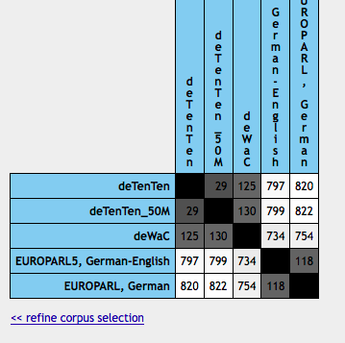

Slide 45
What’s missing
Heterogeneity
“how similar is BNC to WSJ”?
We need to know heterogeneity before we can interpret
The leading diagonal
2001 paper: randomising halves
Inelegant and inefficient
Depended on standard size of document

Slide 46
New definition, method (Pavel)
Heterogeneity (def)
Distance between most different partitions
Cluster to find ‘most different partitions’
Bottom-up clustering
until largest cluster has over one third of data
Rest: the other partition
Problem
nxn distance matrix where n > 1 million
Solution: do it in steps

Slide 47
Summary
Extrinsic evaluation
Method defined
Big project for coming months
Corpus comparison
Qualitative: use keywords
Quantitative
On beta
Heterogeneity (to complete the task) to follow (soon)

Slide 48
you should understand the maths you use

Slide 49
The Sketch Engine
Leading corpus query tool
Widely used by dictionary publishers, at universities
Large corpora for many lgs available
Word sketches
Web service
Since last week:
Implements SimpleMaths

Slide 50
Thank you
http://www.sketchengine.co.uk

Slide 51
Language is never ever ever random

Slide 52
Language

Slide 53
is

Slide 54
never

Slide 55
ever

Slide 56
ever

Slide 57
random

